Slide 1
Developing and Validating Instruments: Basic Concepts and Application of Psychometrics
Session 1: Introduction to Scale Development and Psychometric Properties
Nasir Mushtaq, MBBS, PhD
Department of Biostatistics and Epidemiology
College of Public Health
Department of Family and Community Medicine
School of Community Medicine

Slide 2
Learning Objectives
Describe basic concepts of classical test theory
Describe different types of validity and reliability
Discuss essential components of scale development
Identify the role of psychometric analysis in scale development

Slide 3
Introduction – Key Terms
Measurement
Instruments/Scales/Measures/ Assessment tools/Tests
Latent Variable/Construct
Psychometrics
Reliability
Validity

Slide 4
Measurement
“Methods used to provide quantitative descriptions of the extent to which individuals manifest or possess specified characteristics”
“Assigning of numbers to individuals in a systematic way as a mean of representing properties of the individuals”
“Measurement consist of rules for assigning symbols to objects so as to represent quantities of attributes numerically or define whether the objects fall in the same or different categories with respect to a given attribute (scaling or classification)”

Slide 5
Latent Variable
Latent variable or construct is a hypothetical variable you want to measure
Not directly observable /objectively measure.
A construct is given an operational definition based on a theory
Measured with the observed variables – responses obtained from the scale items

Slide 6
Scales
Scale
  Measurement instrument
  Collection of items
  Items – effect indicators
    Items of a scale share a common cause – latent variable
  Goal is to quantitatively measure a theoretical construct
X1
X1
L
X2
X2
M
X3
X3
Scale
Index

Slide 7
Scales
Components
  Items
    List of short statements or questions to measure the latent variable
  Response options
    Participants indicate the extent to which they agree or disagree with each statement by selecting a response on some rating scale
  Scoring
    Numeric values assigned to each item response
    Overall scale score is calculated

Slide 8
Psychometrics
“The art of imposing measurement and number upon operations of the mind” (Sir Francis Galton, 1879)
“The branch of psychology that deals with the design, administration, and interpretation of quantitative tests for the measurement of psychological variables such as intelligence, aptitude, and personality traits”(The American Heritage Stedman's Medical Dictionary)
“Psychometrics is the construction and validation of measurement instruments and assessing if these instruments are reliable and valid forms of measurement”(Encyclopedia of Behavioral Medicine)

Slide 9
Psychometric Properties
Reliability
  Degree to which a scale consistently measure a construct
Validity
  Degree to which a scale correctly measure a construct
  Reliability is a prerequisite for validity

Slide 10
Classical Test Theory

Slide 11
Classical Test Theory
Evolved in early 1900s from work of Charles Spearman
X = T + E
Assumptions
  True value of the latent variable in a population of interest follows a normal distribution.
  Random error – mean of error scores is zero
  Errors are not correlated with one another
  Errors are not correlated with true value (score)

Slide 12
Classical Test Theory
Domain sampling theory
Domain
  Population or universe of all possible items measuring a single concept or trait (theoretically infinite)
Scale – a sample of items from that universe

Slide 13
Classical Test Theory
Parallel test theory/model
CTT is based on the assumption of parallel tests
Items of a scale are parallel
  Each item’s relationship to the latent variable is identical to every other item’s relationship
X1
e1
L
X2
e2
X3
e3

Slide 14
Classical Test Theory
Parallel test Assumptions
Adds two more assumptions to the CTT assumptions
  Latent variable has same(equal) affect on all items
  Equal variance across items
Other Models
  Tau-equivalent
  Individual item error variances are freed to differ from one another
  Essentially tau-equivalent model
    Item true scores may not be equal across items
  Congeneric Model

Slide 15
Reliability

Slide 16
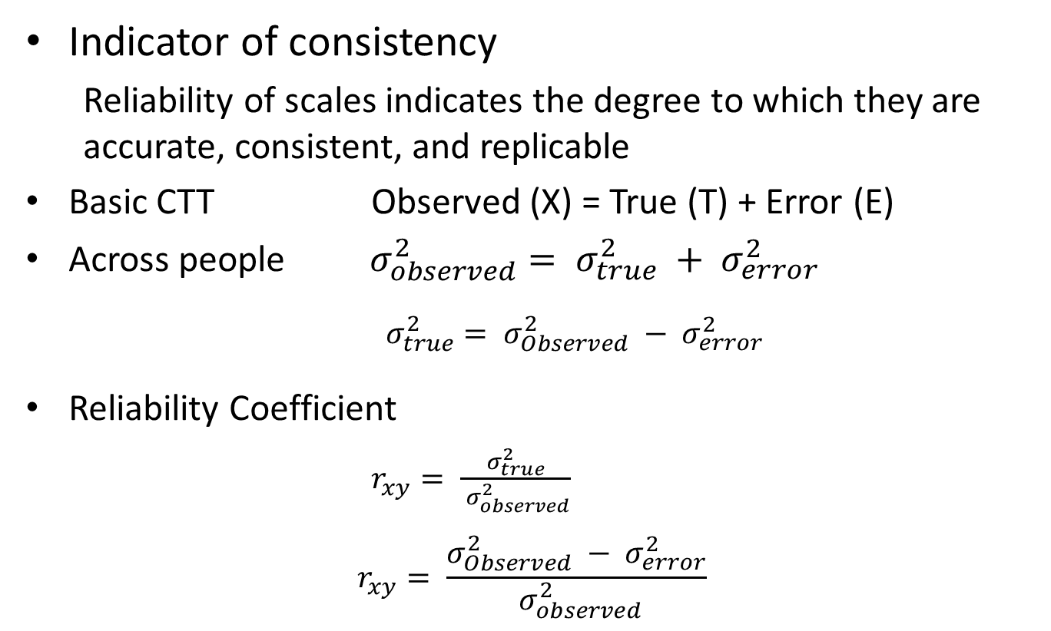
Reliability
Indicator of consistency
  Reliability of scales indicates the degree to which they are accurate, consistent, and replicable
Basic CTT Observed (X) = True (T) + Error (E)
Across people$σ_{observed}^{2}= σ_{true}^{2} + σ_{error}^{2}$
$σ_{true}^{2}= σ_{Observed}^{2} − σ_{error}^{2}$
Reliability Coefficient
$r_{xy}= \frac{σ_{true}^{2}}{{ σ}_{observed}^{2}}$
$$r_{xy}= \frac{σ_{Observed}^{2} − σ_{error}^{2}}{{ σ}_{observed}^{2}}$$

Slide 17

Reliability
Test-Retest Reliability (Temporal Stability)
  Consistency of scale over time
  Scale is administered twice over a period of time to the same group of individuals
  Correlation between scores from T1 and T2 are evaluated
  Memory (Carry over) effect
  True score fluctuation

Slide 18

Reliability
Parallel-Forms (Alternate-Forms) Reliability
  Equivalence of two forms of the same test/scale
  Two parallel forms of a scale are administered to the same sample
  Requirements for parallel forms
    Two versions of the scale measure the same construct
    Same type of items
    Same number of items
  Have to create two versions of the scale (Double the effort!)

Slide 19
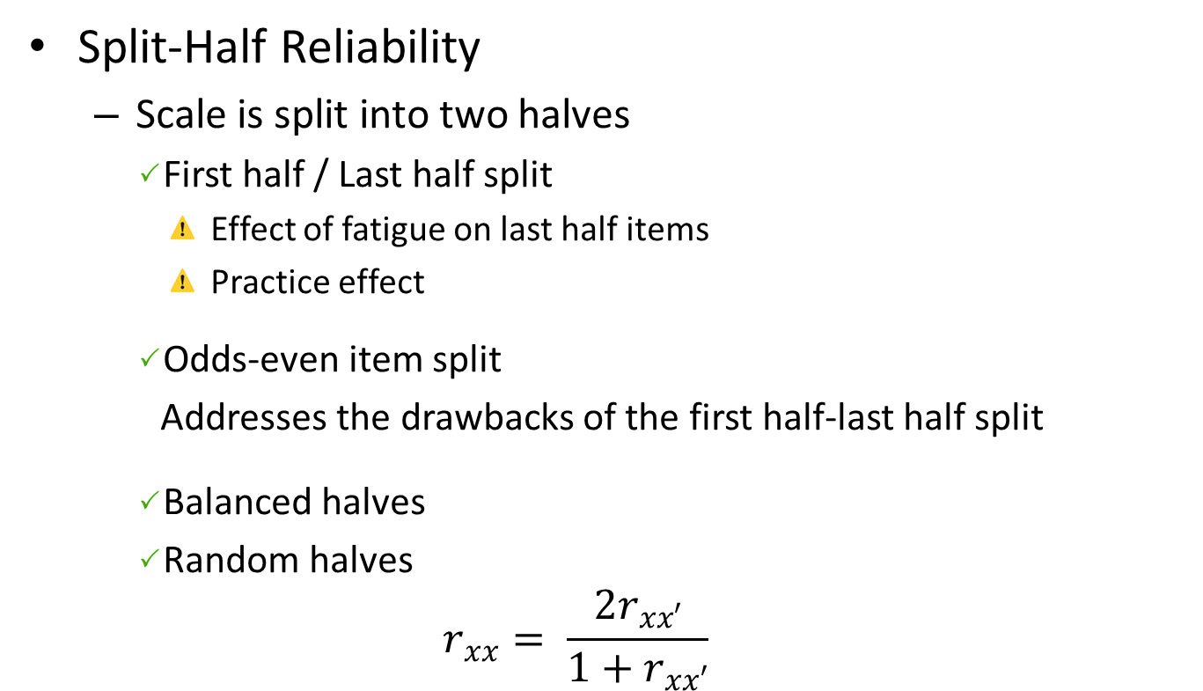
Reliability
Split-Half Reliability
  Scale is split into two halves
    First half / Last half split
      Effect of fatigue on last half items
      Practice effect
    Odds-even item split
    Addresses the drawbacks of the first half-last half split
    Balanced halves
    Random halves
  $$r_{xx}= \frac{{2r}_{xx′}}{1+r_{xx′}}$$

Slide 20
Reliability
Cronbach’s Alpha (Coefficient Alpha)
  Most commonly used measure of internal consistency reliability
  Calculation slightly complex
  Assumptions
    Errors are not correlated with one another
    Other assumptions of essentially tau-equivalent model
  “Alpha is the proportion of a scale’s total variance that is attributable to a common source”

Slide 21
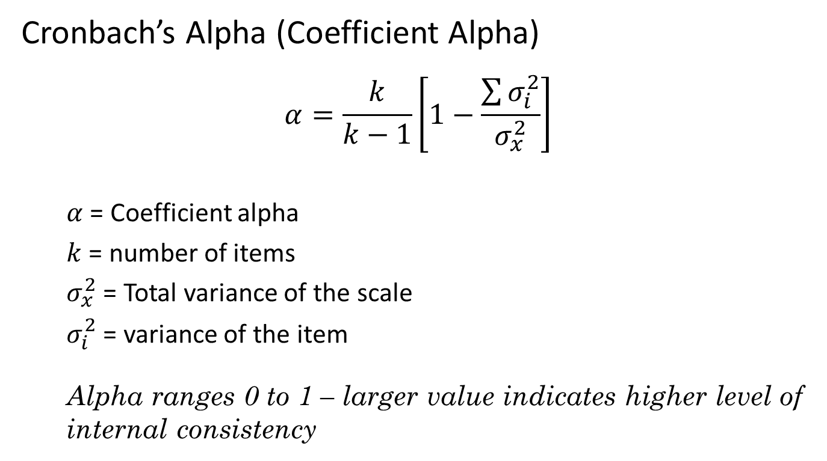
Reliability
Cronbach’s Alpha (Coefficient Alpha)
$$α=\frac{k}{k−1}\left[1−\frac{\sum{σ_{i}^{2}}}{σ_{x}^{2}}\right]$$
  $α$ = Coefficient alpha
  $k$ = number of items
  $σ_{x}^{2}$ = Total variance of the scale
  $σ_{i}^{2}$ = variance of the item
  Alpha ranges 0 to 1 – larger value indicates higher level of internal consistency

Slide 22
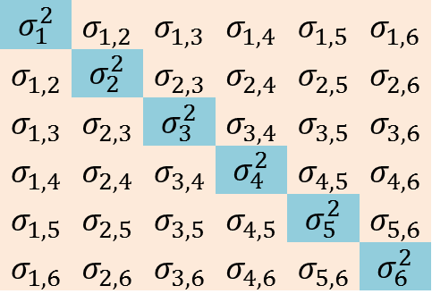
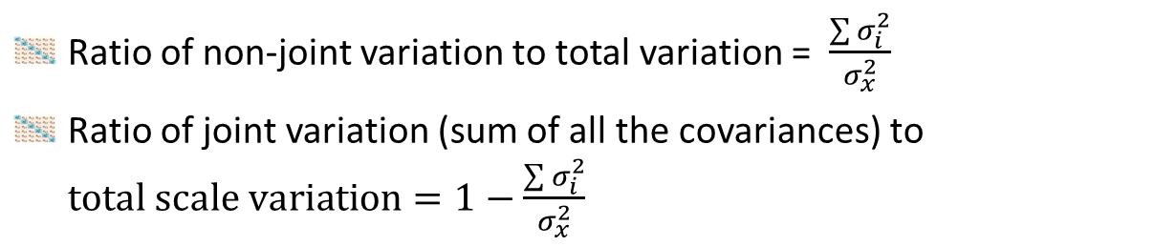
Reliability
Cronbach’s Alpha
Total variance of the scale is the sum of all the elements of the covariance matrix.
Variances at the diagonal and covariances off-diagonal
Covariance Matrix
$$σ_{1}^{2}$$ | $$σ_{1,2}$$ | $$σ_{1,3}$$ | $$σ_{1,4}$$ | $$σ_{1,5}$$ | $$σ_{1,6}$$
$$σ_{1,2}$$ | $$σ_{2}^{2}$$ | $$σ_{2,3}$$ | $$σ_{2,4}$$ | $$σ_{2,5}$$ | $$σ_{2,6}$$
$$σ_{1,3}$$ | $$σ_{2,3}$$ | $$σ_{3}^{2}$$ | $$σ_{3,4}$$ | $$σ_{3,5}$$ | $$σ_{3,6}$$
$$σ_{1,4}$$ | $$σ_{2,4}$$ | $$σ_{3,4}$$ | $$σ_{4}^{2}$$ | $$σ_{4,5}$$ | $$σ_{4,6}$$
$$σ_{1,5}$$ | $$σ_{2,5}$$ | $$σ_{3,5}$$ | $$σ_{4,5}$$ | $$σ_{5}^{2}$$ | $$σ_{5,6}$$
$$σ_{1,6}$$ | $$σ_{2,6}$$ | $$σ_{3,6}$$ | $$σ_{4,6}$$ | $$σ_{5,6}$$ | $$σ_{6}^{2}$$
Ratio of non-joint variation to total variation = $\frac{\sum{σ_{i}^{2}}}{σ_{x}^{2}}$
Ratio of joint variation (sum of all the covariances) to $total scale variation=1−\frac{\sum{σ_{i}^{2}}}{σ_{x}^{2}}$

Slide 23
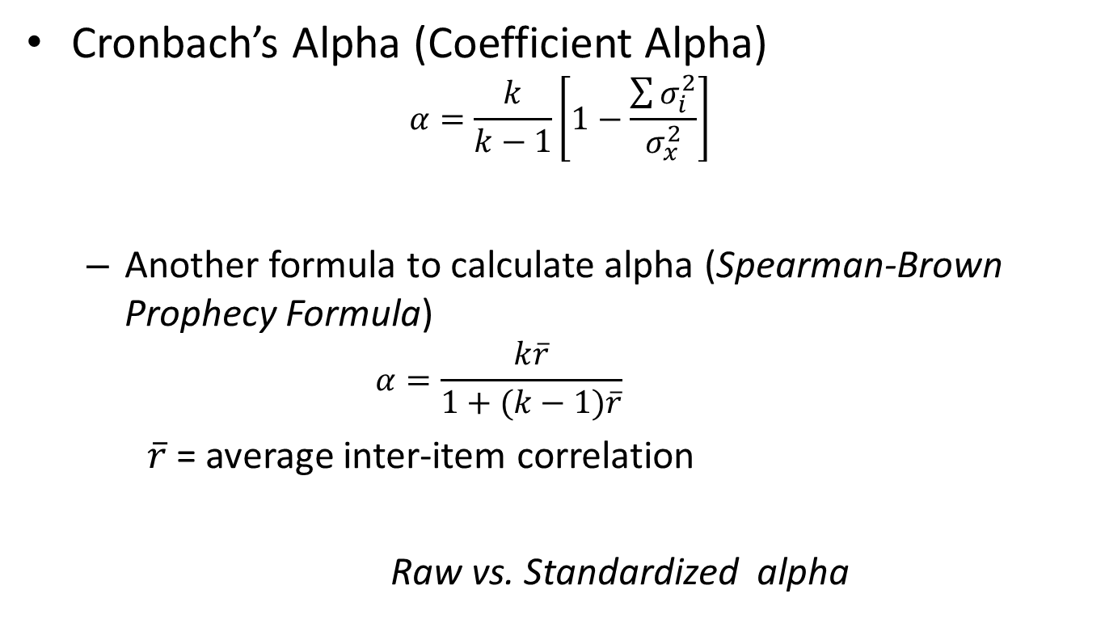
Reliability
Cronbach’s Alpha (Coefficient Alpha)
$$α=\frac{k}{k−1}\left[1−\frac{\sum{σ_{i}^{2}}}{σ_{x}^{2}}\right]$$
  Another formula to calculate alpha (Spearman-Brown Prophecy Formula)
    $$α=\frac{k\overline{r}}{1+(k−1)\overline{r}}$$
    $\overline{r}$ = average inter-item correlation
    Raw vs. Standardized alpha

Slide 24
Reliability
Cronbach’s Alpha (Coefficient Alpha)
  Concerns – violation of assumptions
    Statistical tests to calculate alpha are for continuous data (interval scale)
    Most of the scales use likert scale for responses (ordinal data)
    Use of ordinal alpha or tetrachoric or polychoric correlations
    Assumptions of essentially tau-equivalent model - each item measures the same latent variable on the same scale.
    Items with different response options ( 5 for one item and 3 for other)

Slide 25
Reliability
Threats to Reliability
  Homogeneity of the sample
  Number of items (Length of the scale)
  Quality of the items and complex response options

Slide 26
Validity

Slide 27
Validity
Extent to which a scale is truly measuring what it is intended to measure.
  Does the scale measure the construct under consideration
Types of Validity
  Face Validity
  Content Validity
  Criterion validity
    Concurrent Validity
    Predictive Validity
  Construct Validity

Slide 28
Face Validity
Superficial assessment of the scale
If the scale looks like to measure what it claims to measure
Example:
  Physical dependence on smokeless tobacco (Tolerance)
  I am around smokeless tobacco users much of the time
  How many cans/pouches of smokeless tobacco per week do you use?

Slide 29
Content Validity
Extent to which a scale measures its intended content domain
  Domain Sampling Theory
    An infinite number of items assess a construct
    Scale is a sample of these items
  Content validity assesses sampling adequacy
  Representativeness of the scale for the intended construct
  Qualitative evaluation of the scale
    Expert panel review

Slide 30
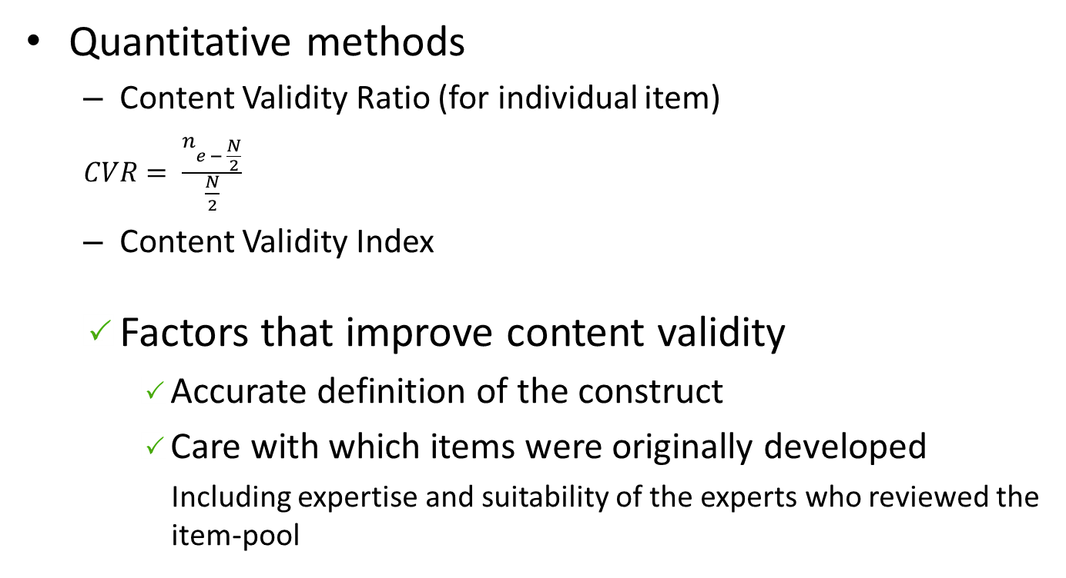
Content Validity
Quantitative methods
  Content Validity Ratio (for individual item)
  $CVR= \frac{n_{e − \frac{N}{2}}}{\frac{N}{2}}$
  Content Validity Index
  Factors that improve content validity
    Accurate definition of the construct
    Care with which items were originally developed
    Including expertise and suitability of the experts who reviewed the item-pool

Slide 31
Criterion Validity
Extent to which a scale is related to another scale/ criterion or predictor
  Concurrent Validity
    Association of the scale under study with an existing scale or criterion measured at the same time
    Examples: New anxiety scale – DSM criteria of anxiety disorder
    Tobacco dependence scale – Nicotine concentration
  Predictive Validity
    Ability of a scale to predict an event, attitude, or outcome measured in the future
    Examples: Tobacco dependence scale – tobacco cessation
    Braden Scale for predicting pressure sore risk - development of pressure ulcers in ICUs

Slide 32
Construct Validity
Extent to which a scale is related to other variables or scales or variables as within the system of theoretical relationships.
  Relies on the theoretical framework used to define the construct
 | Convergent Validity |  | Discriminant Validity
 | Test A | Test B | Test C | Test D
Theoretical | +++ | ++ | 0 | 0
Observed | +++ | ++ | 0 | 0

Slide 33
Scale Development

Slide 34
Scale Development
Theoretical Phase
Defining the construct
Survey Research Phase
Questionnaire Development
Evaluation Phase
Scale length optimization
Item pool generation
Expert panel review
Pilot test
Item Analysis
Inclusion of validation items
Sampling and data collection

Slide 35
Scale Development
Theoretical Phase

Slide 36
Defining the Construct
Vital but the most difficult step in scale development
Well-defined construct helps in writing good items and derive hypotheses for validation purposes
Challenges
  Mostly constructs are theoretical abstractions
  No known objective reality

Slide 37
Defining the Construct
Significance of conceptually developed construct based on theoretical framework
Helps in thinking clearly about the scale contents
Reliable and valid scale
  In-depth literature review
    Grounding the theory
    Review of previous attempts to conceptualize and examine similar or related constructs
  Additional insights from experts and sample of the target population – Concept mapping & Focus group

Slide 38
Defining the Construct
What if there is no theory to guide the investigator?
Still specify conceptual formulation – a tentative theoretical framework to serve as a guide
Other considerations
  Specificity vs. generality
    Broadly measuring an attribute or specific aspect of a broader phenomenon
    If the defined construct is distinct from other constructs
  Better to follow an inductive approach (clearly defined construct a priori) than deductive (exploratory) approach

Slide 39
Defining the Construct
Dimensionality of the construct
Specific and narrowly defined (unidimensional) construct vs. multidimensional construct
Example
  Tobacco dependence
  Four Dimensional Anxiety Scale (FDAS)
How finely the construct to be divided?
  Based on empirical and theoretical evidence
  Purpose of the scale
  Research, diagnostic, or classification information

Slide 40
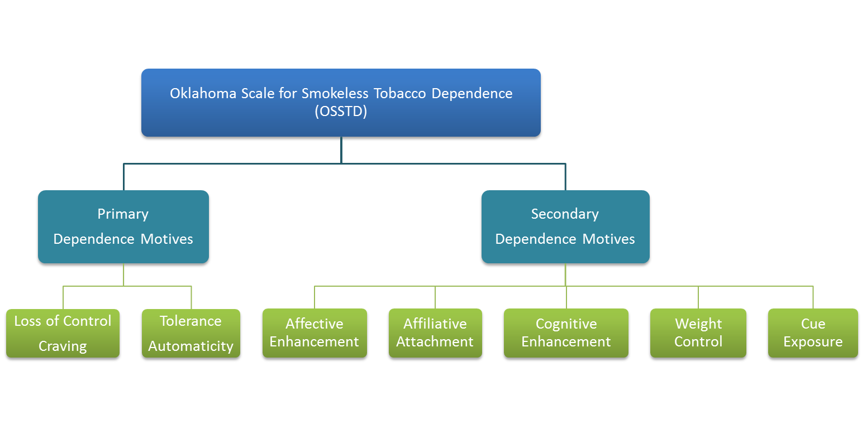
Defining the Construct
Dimensionality of the construct

Slide 41

Defining the Construct
Dimensionality of the construct

Slide 42
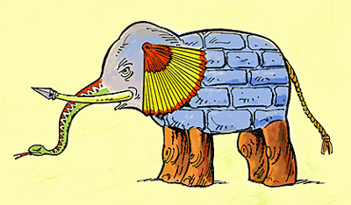
Defining the Construct
Dimensionality of the construct

Slide 43
Defining the Construct
Content Domain
  “Content domain is the body of knowledge, skills, or abilities being measured or examined by a scale”
  Theoretical framework helps in identifying the boundaries of the construct
  Content domain is defined to prevent unintentionally drift into other domain
Clearly defined content domain is vital for content validity

Slide 44
Development of ST Dependence Scale
Theoretical framework
Affective Enhancement
Preoccupation with use
Cognitive Enhancement
Impulsivity
Dependence
= Core Criteria
= Secondary Criteria
= Related Construct
= Observable Properties (e.g., cost, environmental stressor)
Neuroticism
Priority
Diathesis
Observable
Tolerance
Craving
Withdrawal
Observable 1
Observable 6
Observable 2
Observable 7
Observable 3
Observable 8
Observable 4
Observable 5

Slide 45
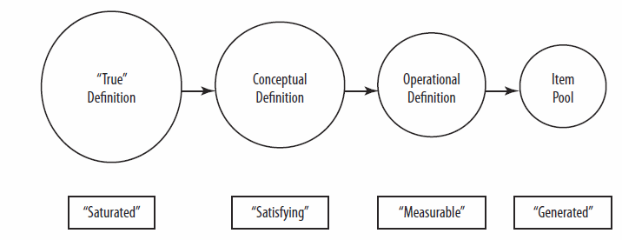
Defining the Construct
Reduction of construct definition in scale development
Source: Developing and Validating Rapid Assessment Instrument

Slide 46
Item Pool Generation
Items should reflect the focus of the scale
  Items are overt manifestations of a common latent variable/construct that is their cause.
  Each item a test, in its own right, of the strength of the latent variable
  Specific to the content domain of the construct
Redundancy
  Theoretical models of scale development are based on redundancy
  At early stage better to be more inclusive

Slide 47
Item Pool Generation
Redundancy
  Redundant with respect to the construct
  Construct-irrelevant redundancies
    Incidental vocabulary and grammatical structure
    Similar wording – e.g., several items starting with the same phrase
    Falsely inflate reliability of the scale
  Type of construct (specific or multidimensional)
    Including more items related to one dimension when a multidimensional construct is considered as unidimensional
    Overrepresentation of one dimension --- biased towards that dimension
    Clear identification of domain boundaries by defining each dimension of the construct.

Slide 48
Item Pool Generation
Number of items
Domain Sampling Model
  Generating items until theoretical saturation is reached
  Initial Pool
    Cannot specify
    3 to 4 times the anticipated number of items in the final scale
    Better to have a larger pool – Not too large to easily administer for pilot testing

Slide 49
Item Pool Generation
Basic rules of writing good items
  Appropriate reading difficulty level
  Avoid too lengthy items
    Conciseness not at the cost of meaning/clarity
  Avoid colloquialisms, expressions, and jargon
  Avoid double barreled questions
    Smoking helps me stay focused because it reduces stress
  Avoid ambiguous pronoun reference
  Avoid the use of negatives to reverse the meaning of an item

Slide 50
Item Pool Generation
Basic rules of writing good items
  Polarity of the items
    Including both positively and negatively worded items in the scale
    Addresses acquiescence or agreement bias
  Confusing for respondents especially for likert type responses and lengthy scales – Such items may perform poorly
  Have to perform reverse coding
  Style and format of items should be according to the measurement scale
 | Not at all | A little | Some | A lot
I feel down and unhappy | 0 | 1 | 2 | 3
I am happy | 3 | 2 | 1 | 0

Slide 51
Rating Scales
Guttman Scale (Cumulative Scale)
  Series of items tapping progressively higher levels of an attribute
  Respondent endorses a block of adjacent items. Endorsing any specific question in the scale will also endorse all previous items
  Example
  1. Have you ever smoked cigarettes?
  2. Do you currently smoke cigarettes?
  3. Do you smoke cigarettes everyday?
  4. Do you smoke a pack of cigarettes everyday?

Slide 52
Rating Scales
Thurstone’s Differential Scale
  Items are differentially responsive to specific levels of the attribute
  Constructing the scale
  Step 1. Write statements(items) about the attribute from extremely favorable to extremely unfavorable
  Step 2. Statements are typed on cards and given to judges
  Step 3. Judges rate each item for its favorability on a 11 point scale with regard to the target construct. Each item will have a numerical rating from each judge.
  Step 4. Items that cannot be rated for favorability or with high degree of variability are eliminated.
  Step 5. Score (weight) assigned to each item based on median and the lowest IQR.
Unfavorable |  | X |  |  |  |  |  |  |  |  |  | Favorable
 |  |  |  |  | Neutral

Slide 53
Rating Scales
Scales with equally weighted items
Response categories
  AUDIT (6 items about the frequency of alcohol use)
  OSSTD (Level of agreement for each item is rated)
  NIHSS (Level of Consciousness – Responsiveness item)
    0. Alert; Responsive
    Not Alert; Verbally arousable
    Not Alert; Only responsive to repeated or strong and painful stimuli
    Totally unresponsive; Responds only with reflexes
Response | Never | Less than Monthly | Monthly | Weekly | Daily or Almost Daily
Score/Points | 0 | 1 | 2 | 3 | 4
Not true of me at all |  |  |  |  |  | Extremely true of me
1 | 2 | 3 | 4 | 5 | 6 | 7

Slide 54
Rating Scales
Scales with equally weighted items
Response categories
  Number of response categories
Increase in number of response categories
Increased variability
Correlate with other measures
  Increase in number of items – increased variability
  Two-item scale with many gradations of response ( 0 to 100 scale) vs. 50-item scale with binary response
  Disadvantage: Survey fatigue – reliability may compromise
  Respondent’s ability to discriminate meaningfully

Slide 55
Rating Scales
Scales with equally weighted items
Response categories
  Wording and placement of response options
  Odds or even numbers (neither format is superior)
  Strongly Agree, Agree, Neither agree nor disagree, Disagree, Strongly Disagree
  Strongly Agree, Agree, Disagree, Strongly Disagree
  Depends on the attribute, item, type of the response option
  Odd number
    Includes a central neutral response
    Bipolar response options
    Permits equivocation (neither agree nor disagree or neutral) or uncertainty (not sure)
  Even numbers
    No neutral point – forced choice

Slide 56
Rating Scales
Likert Scale
Most common scale
Response categories
  Assumption: Equal interval of response continuum
  Common Categories: Agreement, Evaluation, Frequency
  Number of response categories
  Items using likert scale are statements
    Intensity of these statements
    Very mild statements ---- stronger response
    Very strong statements ---- milder response

Slide 57
Rating Scales
Binary scale
Dichotomous options
  Easy to complete --- less survey burden
  Less variability
  More items are required for scale variability

Slide 58
Expert Panel Review
Expert panel
  Subject-matter experts (at least two)
  Individuals from target population
  Psychometricians
Process
  Provide definition of construct
  Items with response options and instructions
  Evaluate items and rate for clarity and relevance
  Feedback about additional ways of tapping the construct
  Final decision ---- investigators

Slide 59
Scale Development
Survey Research Phase

Slide 60
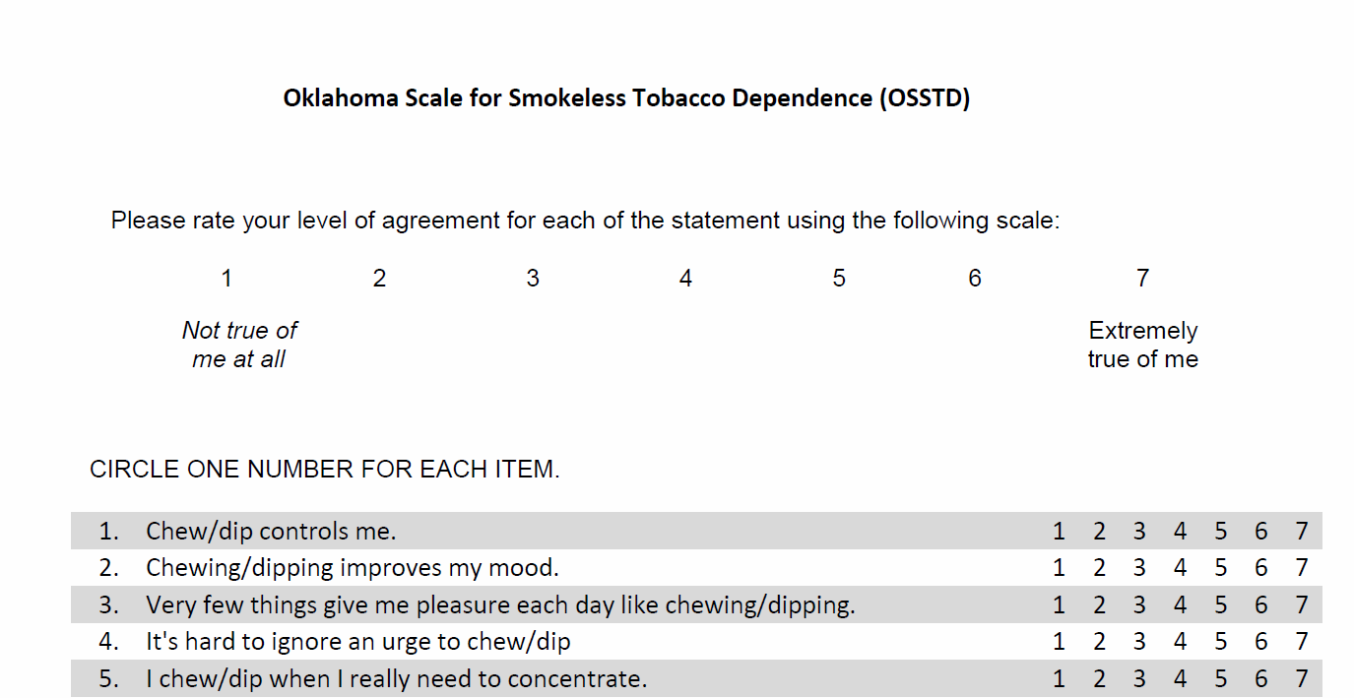
Questionnaire Development
Instructions about completing the scale
Inclusion of validation items
Format - Paper or web-based

Slide 61
Pilot Testing
Sample
  Composition
    Population of interest - Representative of the ultimate population for which scale is intended
        Sample homogeneity
      Sampling
        Preferably - Probability sample
    Acceptable - Purposive or convenience sample
  Sample size 100 to >300
    Also depend on number of items (item pool vs. extracted)
    Smaller sample size 1. Unstable covariation
          2. Potentially nonrepresentativeness

Slide 62
Scale Development
Evaluation Phase

Slide 63
Item Analysis
Most important step – least complex statistical tests
Item-total / Item-scale correlation
  Uncorrected item-scale correlation
  Corrected item-correlation
Item Variance
  Negligible variance vs. Excessively high variance
Item means
  Extreme mean scores
  Floor and Ceiling effects (Extreme mean & Low variance)
  Extreme mean or low variance → low inter-item correlation

Slide 64
Item Analysis
Item retention criteria
  Highest correlation
    Predefined number of items
    Items with the highest correlation coefficient are retained
  Cut-off point
    Criterion based on the magnitude of correlation coefficient
    Impact of number of items and magnitude of correlation coefficient on internal consistency of the scale

Slide 65
Item Analysis
Reliability Coefficient
  Evaluation of the item-retention
  Criteria used for item-selection effect Coefficient alpha
    Item-total correlation, inter-item correlation, variability
  Confirm the internal consistency of the scale
  Alpha values (subjective)
    Acceptable lower bound = 0.70
    Good = 0.70 to 0.80
    Very good = 0.80 – 0.90
    Excellent = 0.90 – 0.95
    More than 0.95 – Suggestive of redundancy
    During the scale development phase better to aim for higher alpha

Slide 66
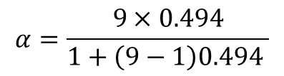
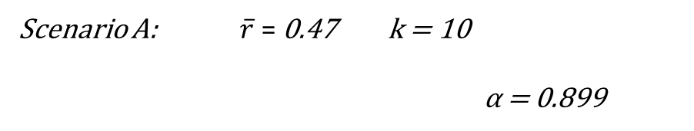
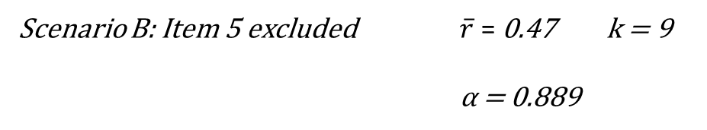
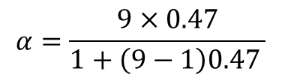
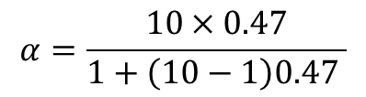

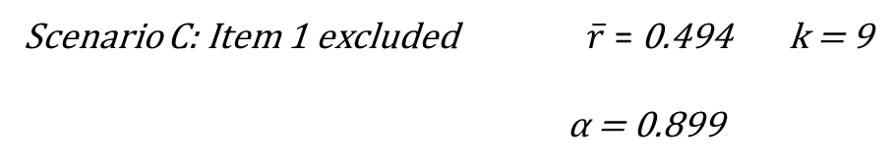
Item Analysis
Effect of number of items on coefficient alpha
$$α=\frac{k\overline{r}}{1+(k−1)\overline{r}}$$
Item | Correlation Coefficient (r)
1 | 0.25
2 | 0.42
3 | 0.48
4 | 0.50
5 | 0.47
6 | 0.38
7 | 0.44
8 | 0.58
9 | 0.57
10 | 0.61
Scenario A: $\overline{r}$ = 0.47 k = 10
α = 0.899
$$α=\frac{10×0.47}{1+\left(10−1\right)0.47 }$$
Scenario B: Item 5 excluded $\overline{r}$ = 0.47 k = 9
α = 0.889
$$α=\frac{9×0.47}{1+\left(9−1\right)0.47 }$$
Scenario C: Item 1 excluded $\overline{r}$ = 0.494 k = 9
α = 0.899
$$α=\frac{9×0.494}{1+\left(9−1\right)0.494 }$$

Slide 67
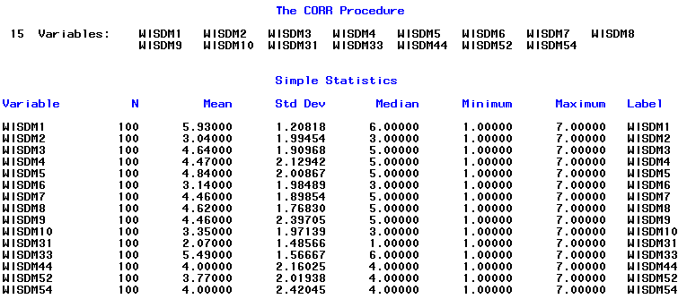
Item Analysis
Item-selection example

Slide 68
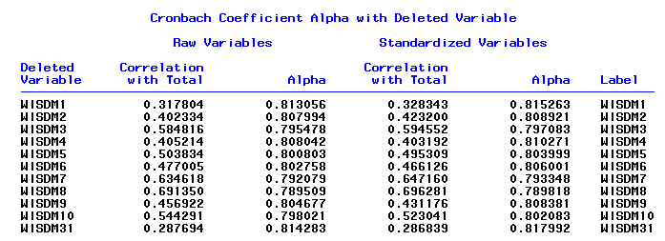

Item Analysis

Slide 69
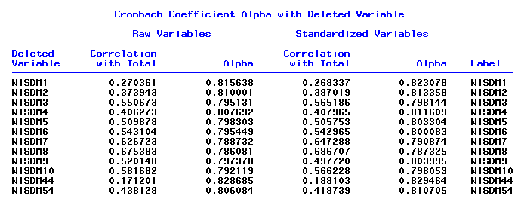
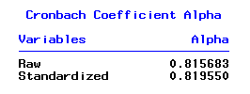
Item Analysis

Slide 70
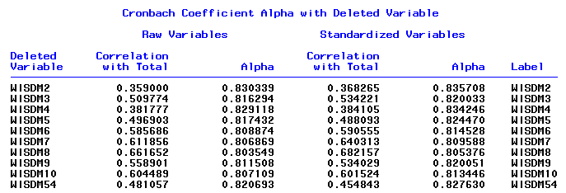

Item Analysis

Slide 71
Item Analysis
Item selection – External Criteria
  Retain or drop items based on their relation with other scale or variable
  Helps in reducing bias
    E.g., Social desirability bias

Slide 72
Scale Length Optimization
Based on the construct
Shorter scale – less survey burden
Longer scale – more reliable

Slide 73
Issues in Scale Development
Sufficient internal consistency is not achieved
  Evaluate construct definition – vaguely defined or too broad
    A multidimensional construct wrongly considered as a unidimensional and scale items tap into different aspects of the construct
    Redefine the construct and develop subscales
    A unidimensional construct considered as a multidimensional and the assumed dimensions are not related
    Redefine the construct and write items related to the construct
  Low alpha - Include additional items

Slide 74

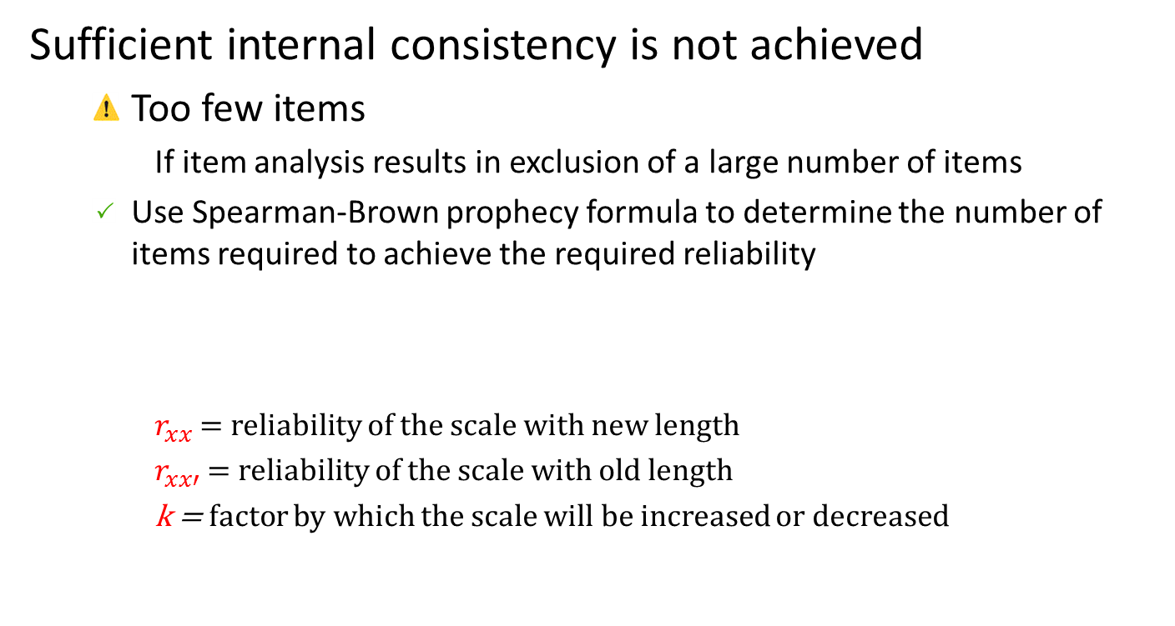
Issues in Scale Development
Sufficient internal consistency is not achieved
  Too few items
    If item analysis results in exclusion of a large number of items
  Use Spearman-Brown prophecy formula to determine the number of items required to achieve the required reliability
$r_{xx}$ = reliability of the scale with new length
$r_{xx′}$ = reliability of the scale with old length
k = factor by which the scale will be increased or decreased
    $$r_{xx}= \frac{{kr}_{xx′}}{1+(k−1)r_{xx′}}$$

Slide 75
Issues in Scale Development
Inter-Item and Item-to-Criterion Paradox
  Multidimensional construct
  Highly homogeneous scale items
    High inter-item correlations
    Total score may not relate well to the criterion
  Heterogeneous scale items
    Low inter-item correlations
    Total score is likely to relate well to the criterion
  Reliability at the cost of content validity

Slide 76
Scale Evaluation
Psychometric properties
  Reliability
  Validity
  Structure model
    Dimensionality

Slide 77
References
Abell, N., Springer, D. W., & Kamata, A. (2009). Developing and validating rapid assessment instruments. Oxford ; New York: Oxford University Press.
DeVellis, R. F. (2017). Scale development : theory and applications (Fourth edition). Los Angeles: SAGE.
Dimitrov, D. M. (2012). Statistical methods for validation of assessment scale data in counseling and related fields. Alexandria, VA: American Counseling Association.
Nunnally, J. C., & Bernstein, I. H. (1994). Psychometric theory (Third Edition). New York: McGraw-Hill.
Shultz, K. S., Whitney, D. J., & Zickar, M. J. (2014). Measurement theory in action : case studies and exercises (Second Edition). New York: Routledge.
Spector, P. E. (1992). Summated Rating Scale Construction: An Introduction (Second Edition): SAGE Publications.

