Slide 1
Developing and Validating Instruments: Basic Concepts and Application of Psychometrics Session 2: Psychometric Analysis for Scale Validation
Nasir Mushtaq, MBBS, PhD
Department of Biostatistics and Epidemiology
College of Public Health
Department of Family and Community Medicine
School of Community Medicine

Slide 2
Learning Objectives
Describe psychometric properties and essential components of scale validation
Discuss different statistical methods and procedures to evaluate pertinent psychometric properties of scales
Understand and explain the program syntax and resulting output from statistical packages used for psychometric analysis

Slide 3
Psychometric Analysis
Analysis of scales (measurement instruments) to ensure these are
Reliable
Valid
Objective
Improve a scale
Validate

Slide 4
Reliability

Slide 5
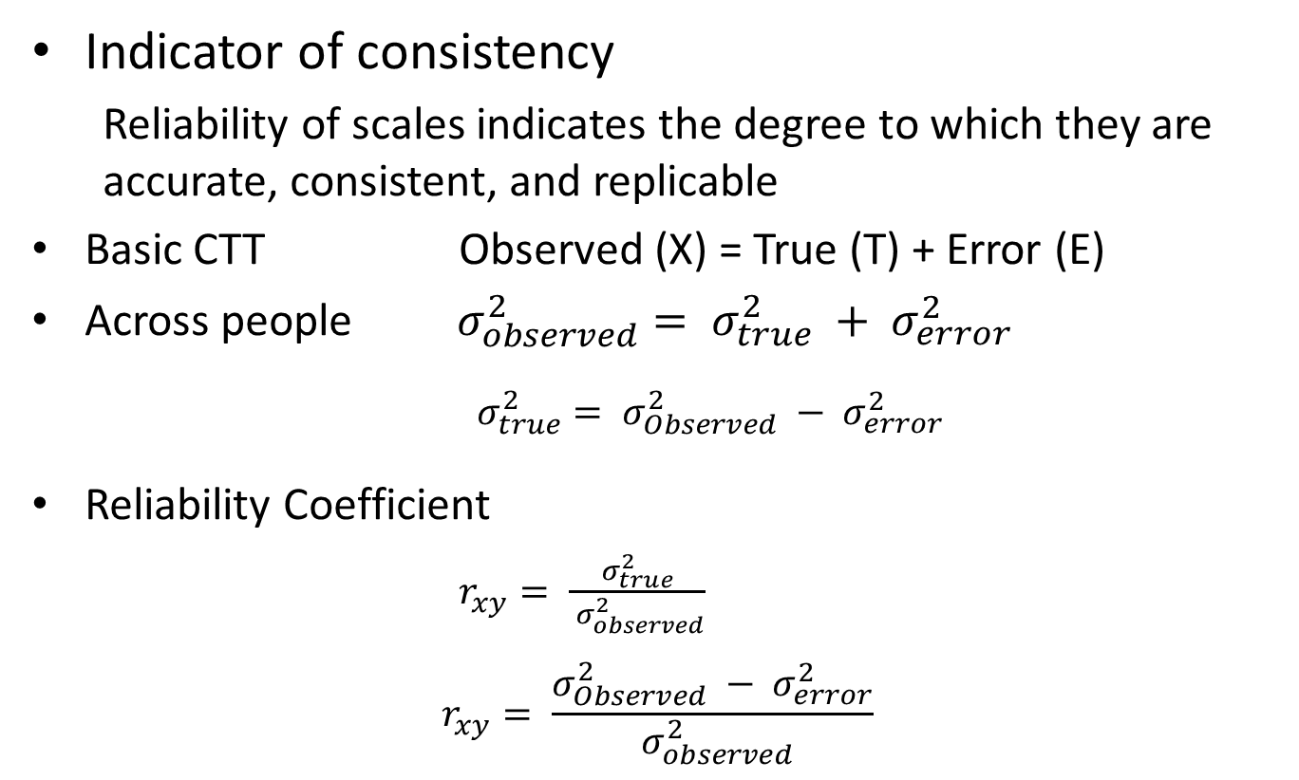
Reliability
Indicator of consistency
Reliability of scales indicates the degree to which they are accurate, consistent, and replicable
Basic CTT Observed (X) = True (T) + Error (E)
Across people$σ_{observed}^{2}= σ_{true}^{2} + σ_{error}^{2}$
$σ_{true}^{2}= σ_{Observed}^{2} − σ_{error}^{2}$
Reliability Coefficient
$r_{xy}= \frac{σ_{true}^{2}}{{ σ}_{observed}^{2}}$
$$r_{xy}= \frac{σ_{Observed}^{2} − σ_{error}^{2}}{{ σ}_{observed}^{2}}$$

Slide 6
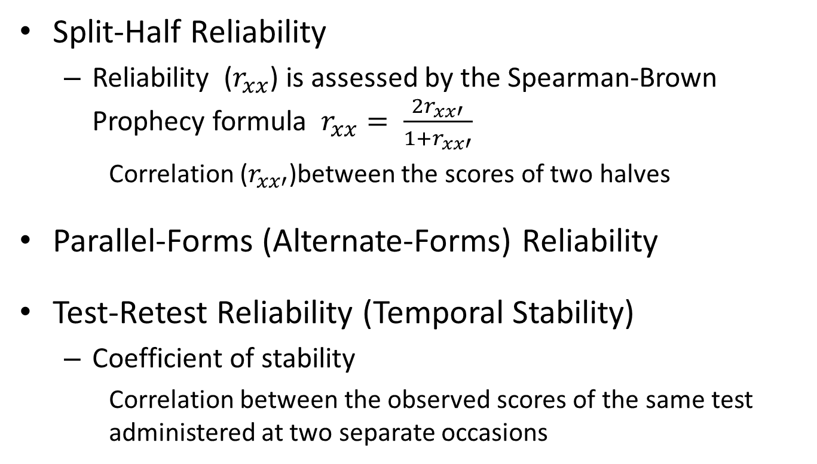
Reliability
Split-Half Reliability
Reliability ($r_{xx}$) is assessed by the Spearman-Brown Prophecy formula $r_{xx}= \frac{{2r}_{xx′}}{1+r_{xx′}}$
Correlation ($r_{xx′}$)between the scores of two halves
Parallel-Forms (Alternate-Forms) Reliability
Test-Retest Reliability (Temporal Stability)
Coefficient of stability
Correlation between the observed scores of the same test administered at two separate occasions

Slide 7
Reliability
Methods to measure internal consistency reliability for scale validation
Cronbach’s alpha
Item-total correlation
Inter-item correlation

Slide 8
Reliability
Cronbach’s Alpha (Coefficient Alpha)
Most commonly used measure of internal consistency reliability
Calculation slightly complex
Assumptions
Errors are not correlated with one another
Other assumptions of essentially tau-equivalent model
“Alpha is the proportion of a scale’s total variance that is attributable to a common source”

Slide 9
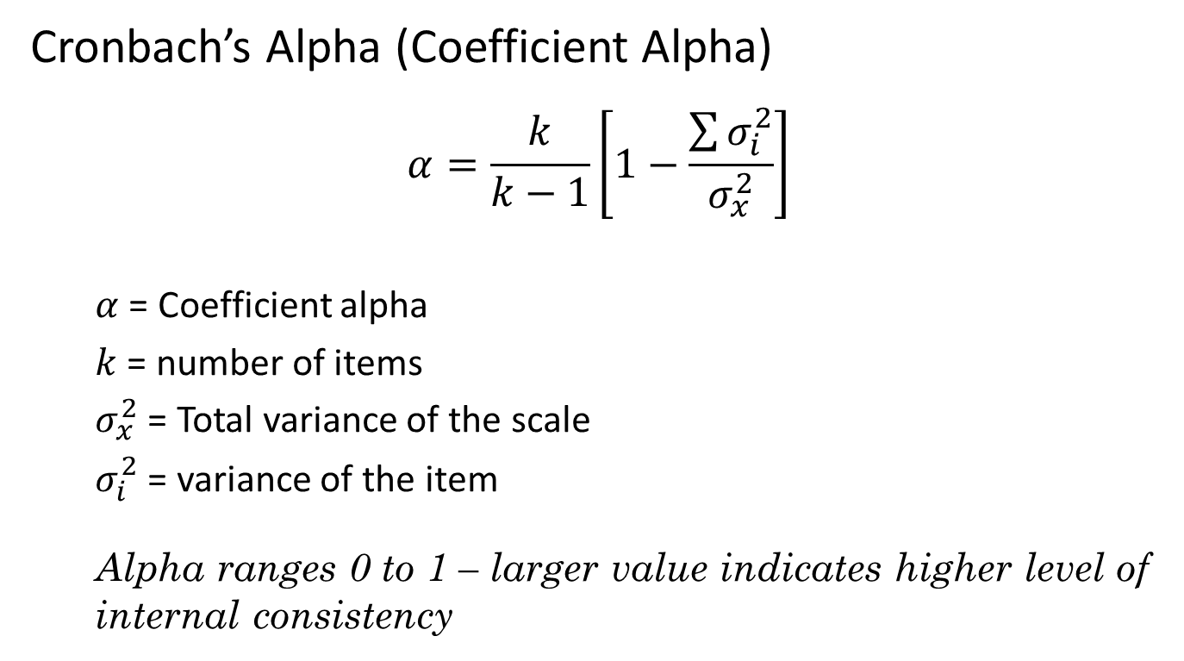
Reliability
Cronbach’s Alpha (Coefficient Alpha)
$$α=\frac{k}{k−1}\left[1−\frac{\sum{σ_{i}^{2}}}{σ_{x}^{2}}\right]$$
$α$ = Coefficient alpha
$k$ = number of items
$σ_{x}^{2}$ = Total variance of the scale
$σ_{i}^{2}$ = variance of the item
Alpha ranges 0 to 1 – larger value indicates higher level of internal consistency

Slide 10
Example
Cross Sectional Study Design
Data
Community based sample, n=95
Self administered mail survey of adult current exclusive ST users
ST Dependence Measures
Fagerström Test of Nicotine Dependence (FTND-ST)
Six items scale
Total scale ranges from 0 to 10
Salivary cotinine concentration
Tobacco Dependence Screener (TDS)
Oklahoma Scale for Smokeless Tobacco Dependence (OSSTD)

Slide 11
Example
Table 1. Response to FTND-ST items
FTND items with response (scores) | n (%)
How soon after you wake up to do you place your first dip?
Within 5 minutes (3) | 8 (8.42)
6 – 30 minutes (2) | 32 (33.68)
31 – 60 minutes (1) | 17 (17.89)
After 60 minutes (0) | 38 (40.00)
2. How often do you intentionally swallow tobacco juice?
Always (2) | 10 (10.53)
Sometimes (1) | 34 (35.79)
Never (0) | 51 (53.68)
3. Which chew would you hate to give up most?
The first one in the morning (1) | 41 (43.16)
Any other (0) | 54 (56.84)
4. How many cans/pouches per week do you use?
More than 3 (2) | 37 (38.95)
2 – 3 (1) | 43 (45.26)
1 (0) | 15 (15.79)
5. Do you chew more frequently during the first hours after awakening than during the rest of the day?
Yes (1) | 14 (14.74)
No (0) | 81 (85.26)
6. Do you chew if you are so ill that you are in bed most of the day?
Yes (1) | 34 (35.79)
No (0) | 61 (64.21)

Slide 12
Reliability
Cronbach’s Alpha (Coefficient Alpha)
SAS Syntax
Proc Corr Data=FTND NoCorr ALPHA NOMISS;
Var FTND_1 FTND_2 FTND_3 FTND_4 FTND_5 FTND_6;
Run;
Alpha: Cronbach’s Alpha
NoCorr
NoMiss

Slide 13
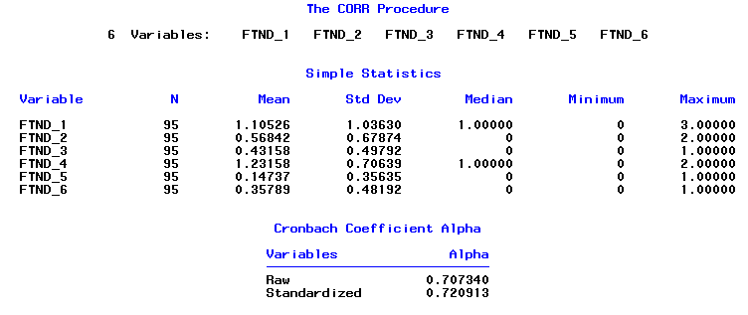
Reliability
Cronbach’s Alpha (Coefficient Alpha)
SAS Output
Raw α → based on covariance matrix
Standardized α → based on the correlation matrix

Slide 14
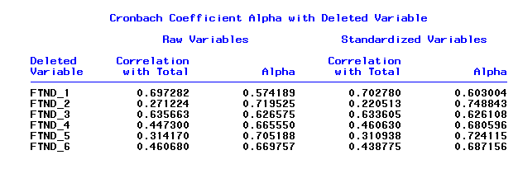
Reliability
Cronbach’s Alpha (Coefficient Alpha)
SAS Output

Slide 15
Reliability
Item-total correlation
Zero-order correlation between total score and items
Inter-item correlation
Zero-order correlation between items
SAS Syntax
Proc Corr Data=FTND PEARSON SPEARMAN NOMISS;
Var FTNDTotal FTND_1 FTND_2 FTND_3 FTND_4 FTND_5 FTND_6;
Run;
Pearson: Pearson product moment correlation
Spearman: Spearman rank-order correlation

Slide 16
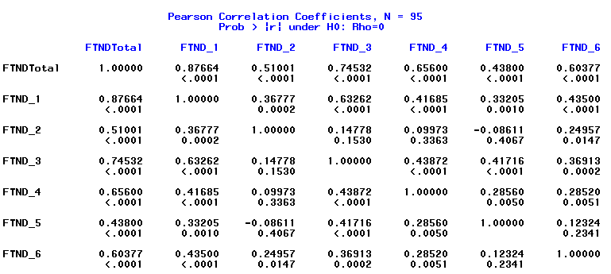
Reliability
Item-total correlation
SAS Output

Slide 17
Reliability
Inter-item correlation
SAS Output

Slide 18
Reliability
Internal consistency criteria
* α > 0.95 indicates redundancy
Measure | Criteria
Cronbach’s Alpha | > 0.70*
Item-total correlation | > 0.20
Inter-item correlation | 0.15 – 0.85

Slide 19

Reliability
Threats to Reliability
Homogeneity of the sample
Number of items (Length of the scale)
Quality of the items and complex response options

Slide 20
Validity

Slide 21
Validity
Extent to which a scale is truly measuring what it is intended to measure.
Does the scale measure the construct under consideration
Types of Validity
Face Validity
Content Validity
Criterion validity
Concurrent Validity
Predictive Validity
Construct Validity
Qualitative Methods
Quantitative Methods

Slide 22
Face Validity
Superficial assessment of the scale
If the scale looks like to measure what it claims to measure
Example:
Physical dependence on smokeless tobacco (Tolerance)
I am around smokeless tobacco users much of the time
How many cans/pouches of smokeless tobacco per week do you use?
Face validity of the following in measuring tobacco dependence:
I enjoy the sensations of a long, slow exhalation of smoke.

Slide 23
Content Validity
Extent to which a scale measures its intended content domain
Domain Sampling Theory
An infinite number of items assess a construct
Scale is a sample of these items
Content validity assesses sampling adequacy
Representativeness of the scale for the intended construct
Qualitative evaluation of the scale

Slide 24
Validity Criterion Validity

Slide 25
Criterion Validity
Extent to which a scale is related to another scale/ criterion or predictor
Concurrent Validity
Association of the scale under study with an existing scale or criterion measured at the same time
Predictive Validity
Ability of a scale to predict an event, attitude, or outcome measured in the future

Slide 26
Concurrent Validity
Criterion variable (Gold standard)
Previously validated measure
Scales measuring the same broader construct
Same or other dimensions the construct
Other characteristics
Factors related to the same domain
Assessed at the same time (concurrently) when the scale under study was administered

Slide 27
Concurrent Validity
Example – Evaluation of FTND-ST
Criterion Variable
Salivary cotinine concentration
Other ST dependence scales
Tobacco Dependence Screener (TDS) based on DSM-IV & ICD-10
Oklahoma Scale for Smokeless Tobacco Dependence (OSSTD)
Severson Smokeless Tobacco Dependence Scale (SSTDS)
ST use characteristics
Quantity of ST use (number of cans per week – CPW)
Frequency of ST use (number of dips per day – DPD)
Duration of ST use (years of ST use)

Slide 28
Concurrent Validity
Example – Evaluation of FTND-ST
Statistical Test – Correlation analysis
SAS Syntax
Proc Corr Data=FTND;
Var FTNDTotal SCotinine TDSTotal OSSTD SSTDS CPW DPD STUseYr;
Run;

Slide 29
Concurrent Validity
Example – Evaluation of FTND-ST
Results
Table 2. Zero order correlation between FTND-ST and other dependence measures (Concurrent validity)
Dependence Measure | r (p-value)
Cotinine | 0.620 ( <0.0001)
TDS | 0.436 ( <0.0001)
OSSTD | 0.526 ( <0.0001)
CPW | 0.620 ( <0.0001)
DPD | 0.478 ( <0.0001)
Years of ST use | 0.508 ( <0.0001)

Slide 30
Concurrent Validity
Example – Evaluation of FTND-ST
Statistical Test – Simple Linear Regression
Proc Reg Data=FTND;
Model SCotinine = FTNDTotal;
Run;
%Macro TUC (var1=);
Proc Reg Data=FTND;
Model FTNDTotal = &var1;
Run;
%Mend;
%TUC (var1=TDSTotal); %TUC (var1=SCotinine); %TUC (var1=CPW); %TUC (var1=DPD); %TUC (var1=STUseYr); End;
OR

Slide 31
Concurrent Validity
Example – Evaluation of FTND-ST
Table 3. Association of FTND-ST with other dependence measures and tobacco use characteristics – Results of simple linear regression analysis
Dependence Measures / ST Use Characteristics | Parameter Estimate | Standard Error | t-test | p-value | r²
Cotinine | 0.170 | 0.022 | 7.62 | <0.0001 | 0.385
TDS | 0.423 | 0.091 | 4.67 | <0.0001 | 0.190
CPW | 0.706 | 0.093 | 7.61 | <0.0001 | 0.384
DPD | 0.269 | 0.051 | 5.25 | <0.0001 | 0.229
Years of ST use | 0.116 | 0.020 | 5.68 | <0.0001 | 0.258

Slide 32
Concurrent Validity
Example – Evaluation of FTND-ST items
Correlation analysis
Table 4. Association between cotinine and FTND-ST items
 | FTND-ST item r (p-value)
 | Item 1 | Item 2 | Item 3 | Item 4 | Item 5 | Item 6
Cotinine | 0.663 (<0.0001) | 0.418 (<0.0001) | 0.385 (0.0001) | 0.324 (0.0013) | 0.123 (0.236) | 0.285 (0.005)
TDS | 0.373 (0.0002) | 0.224 (0.0294) | 0.276 (0.0068) | 0.143 (0.1679) | 0.310 (0.0022) | 0.454 (<0.0001)

Slide 33
Concurrent Validity
Example – Evaluation of FTND-ST items
Multiple regression analysis
SAS Syntax
Proc Reg Data=FTND;
Model SCot = FTND_1 - FTND_6;
Run;

Slide 34
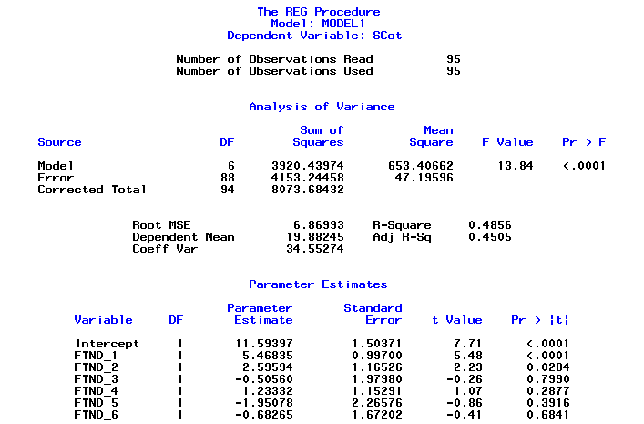
Concurrent Validity
Example – Evaluation of FTND-ST items
Multiple regression analysis

Slide 35
Predictive Validity
Ability of a scale to predict an event, attitude, or outcome measured in the future
Example
Predictive validity of FTND-ST for assessing ST cessation.
Predictive validity of Braden scale for assessing the risk of pressure ulcers.
Statistical tests
Correlation analysis
Regression analysis

Slide 36
Validity Construct Validity

Slide 37
Construct Validity
Relies on the theoretical framework used to define the construct
Convergent Validity and Discriminant Validity
Extent to which a scale is related to other variables or scales within the system of theoretical relationships.
Structure model (Factor analysis)
Scale dimensionality
 | Convergent Validity |  | Discriminant Validity
 | Test A | Test B | Test C | Test D
Theoretical | +++ | ++ | 0 | 0
Observed | +++ | ++ | 0 | 0

Slide 38
Factor Analysis
Identify latent factors underlying a set of observable variables
Types
Exploratory Factor Analysis (EFA)
Data-driven approach to discover/explore unknown factorial structures
Confirmatory Factor Analysis (CFA)
Theory-driven approach to confirm hypothesized factorial structures

Slide 39
Exploratory Factor Analysis
Performed in the absence of sufficient theoretical or empirical information about the structure model of the scale.
Appropriate number of underlying factors are determined.
Unidimensional vs. multidimensional
Methods to extract factors:
Principal factor, maximum likelihood, unweighted least squares, etc.
Rotation of factors
Orthogonal rotations (Varimax): Forces the resulting factors to be uncorrelated.
Oblique rotations (Promax): Allows correlations between the factors

Slide 40
Exploratory Factor Analysis
Criteria for extracting factors:
Kaiser eigenvalue criteria
Factors with eigenvalues > 1
Scree test
Examine scree plot. Magnitude of eigenvalues on Y-axis and number of factors on X-axis. Retain factors above the elbow.
Proportion of variance accounted for
Retain a factor if it accounts for more than a specified proportion of variance in the dataset.

Slide 41
Exploratory Factor Analysis
Criteria for extracting factors
Interpretability criteria
Factors with > 3 with significant factor loadings.
Variables that load on a factor share some conceptual meaning.
Variables that load on different factors measure different construct/dimension.
Rotated factor pattern demonstrate simple structure
High loadings on one factor
Low loadings on other factors
Parallel test
Velicer’s MAP test

Slide 42
Exploratory Factor Analysis
SAS Syntax
Proc Factor Data=EFA
Simple Method=Prin
Priors=SMC Scree
Rotate=Varimax Round
Flag=0.4 Mineigen=1
Nfact=2;
Var ______________;
Run;

Slide 43
Exploratory Factor Analysis
Example – OSSTD
Primary Dependence Motives (PDM) Subscale
Item No. | Items | Response
1 | Chew/dip controls me. | 1 | 2 | 3 | 4 | 5 | 6 | 7
2 | I'm really hooked on chew/dip. | 1 | 2 | 3 | 4 | 5 | 6 | 7
3 | It's hard to ignore an urge to chew/dip | 1 | 2 | 3 | 4 | 5 | 6 | 7
4 | I frequently crave chew/dip. | 1 | 2 | 3 | 4 | 5 | 6 | 7
5 | Other chewers/ dippers would consider me a heavy chewer/dipper. | 1 | 2 | 3 | 4 | 5 | 6 | 7
6 | I chew/dip within the first 30 minutes of awakening in the morning. | 1 | 2 | 3 | 4 | 5 | 6 | 7
7 | I find myself reaching for chew/dip without thinking about it. | 1 | 2 | 3 | 4 | 5 | 6 | 7
8 | Sometimes I am not aware that I am chewing/dipping. | 1 | 2 | 3 | 4 | 5 | 6 | 7

Slide 44
Exploratory Factor Analysis
Example – Orthogonal Rotation
SAS Syntax
ODS Graphics ON;
Proc Factor Data=OSCTR_EFA Simple Method=Prin Priors=SMC Plot=Scree Rotate=Varimax
Round Flag=0.4;
Var OSSTD1 OSSTD2 OSSTD3 OSSTD4 OSSTD5 OSSTD6 OSSTD7 OSSTD8;
Run;
ODS Graphics OFF;

Slide 45
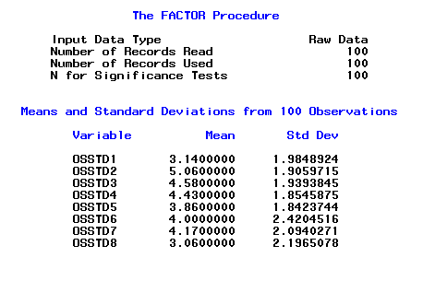
Exploratory Factor Analysis
SAS Output

Slide 46
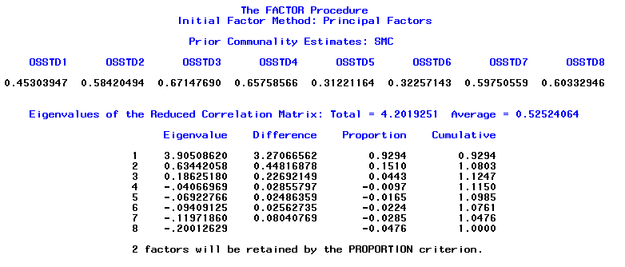
Exploratory Factor Analysis
SAS Output

Slide 47
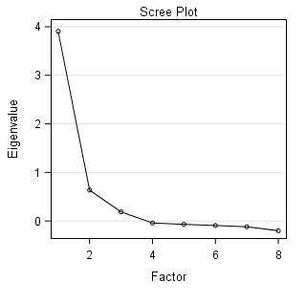
Exploratory Factor Analysis
SAS Output

Slide 48
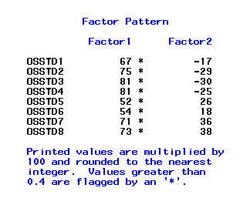
Exploratory Factor Analysis
SAS Output

Slide 49
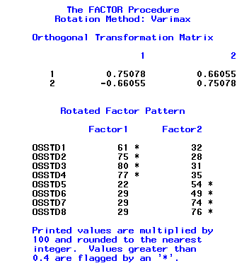
Exploratory Factor Analysis
SAS Output

Slide 50
Exploratory Factor Analysis
Example – Oblique Rotation
SAS Syntax
Proc Factor Data=OSCTR_EFA Simple Method=Prin Priors=SMC Plot=Scree Rotate=Promax
Round Flag=0.4;
Var OSSTD1 OSSTD2 OSSTD3 OSSTD4 OSSTD5 OSSTD6 OSSTD7 OSSTD8;
Run;

Slide 51
Exploratory Factor Analysis
SAS Output

Slide 52
Exploratory Factor Analysis
SAS Output

Slide 53
Exploratory Factor Analysis
SAS Output

Slide 54
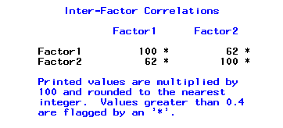
Exploratory Factor Analysis
SAS Output
Factors are correlated (r=0.62)

Slide 55
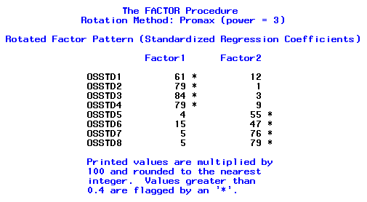
Exploratory Factor Analysis
SAS Output

Slide 56
Exploratory Factor Analysis
Theoretically verify EFA results
Item No. |  | Factors / Items
Factor 1: Loss of Control and Craving
1 | Chew/dip controls me.
2 | I'm really hooked on chew/dip.
3 | It's hard to ignore an urge to chew/dip
4 | I frequently crave chew/dip.
Factor 2: Tolerance and Automaticity
5 | Other chewers/ dippers would consider me a heavy chewer/dipper.
6 | I chew/dip within the first 30 minutes of awakening in the morning.
7 | I find myself reaching for chew/dip without thinking about it.
8 | Sometimes I am not aware that I am chewing/dipping.

Slide 57
Confirmatory Factor Analysis
CFA is used to test the validity of a hypothesized structure model.
Theory–driven approach to confirm factorial structure.
A priori
Number of factors
Loading of observed variables on each factor
Relationship between factors
Statistical Programs
AMOS, MPLUS, LISREL, EQS
SAS

Slide 58
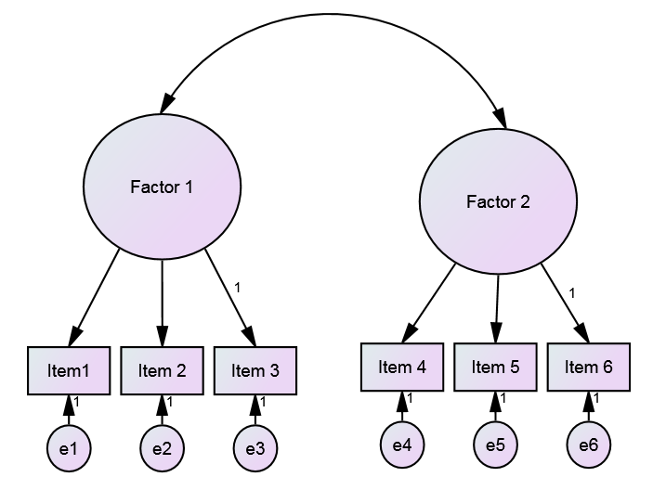
Confirmatory Factor Analysis
Two-Factor Structure Model

Slide 59
Confirmatory Factor Analysis
Testing the structure model
Evaluation of factor loadings and factor correlations
More than a dozen indexes
Fit Indexes
Pearson chi-square (χ²)
Most commonly reported index of model fit
H₀: Model accurately represents the data
Nonsignificant χ² test indicates – model fits the data
Limitation – Sample size effect
Larger sample size (>200) → Significant test
(Artificial tendency to reject the model fit)
Small sample size → Nonsignificant test
(Artificial tendency to support the model fit)

Slide 60

Confirmatory Factor Analysis
Fit Indexes
Goodness of Fit Index (GFI)
Similar to R² in multiple regression – Proportion of variance and covariance accounted for by the model.
GFI > 0.90 indicates good model fit.
Limitation – Effect of number of parameters estimated
Higher the number of parameters / complex models → Higher GFI
Adjusted Goodness of Fit Index (AGFI)
Similar to GFI
Takes into account the effect of number of parameter to estimate
Same criteria for model fit as for GFI

Slide 61
Confirmatory Factor Analysis
Fit Indexes
Comparative Fit Index (CFI)
Indicates the proportion of improvement in fit from null model to hypothesized model.
Less influenced by sample size.
CFI > 0.90 → Acceptable model fit
Tucker Lewis Index (TLI)/Non-normed Fit Index (NNFI)
Similar to CFI
Takes into account the effect of model complexity
Same criteria for model fit as for CFI

Slide 62
Confirmatory Factor Analysis
Fit Indexes
Standardized Root Mean Square Residual (SRMR)
Compares observed covariance estimates with the expected covariance if the model is correct.
Sample size or number of parameters → smaller SRMR
SRMR < 0.08 → acceptable fit (0 indicates perfect fit)
Root Mean Square Error of Approximation (RMSEA)
Similar to RMSEA.
Less affected by the sample size.
Confidence intervals can also be computed.
RMSEA < 0.08 → acceptable fit

Slide 63
Confirmatory Factor Analysis
Fit Indexes
Akaike Information Criterion (AIC) and Bayesian Information Criterion (BIC)
Useful for comparing alternative factor models.
Model with smaller AIC/BIC value has better fit.
Other Indexes
Chi-square to degrees of freedom ratio (χ²/df)
Normed Fit Index (NFI)
Relative Fit Index (RFI)

Slide 64
Confirmatory Factor Analysis
Model Fit Indexes - Summary
Fit Indexes | Model Fit Criteria
 | Acceptable | Good/Close | Excellent or Exact
Pearson chi-square (χ²) | p > 0.05
Chi-square to degrees of freedom ratio (χ²/df) | < 2.0
Goodness of fit (GFI) | > 0.90
Adjusted goodness of fit (AGFI) | > 0.90
Comparative fit index (CFI) | 0.90 – 0.95 | 0.95 – 0.99 | 1.00
Tucker-Lewis index (TLI) | 0.90 – 0.95 | 0.95 – 0.99 | 1.00
Standardized root mean square residual (SRMR) | < 0.08
Root mean square error of approximation (RMSEA) | 0.05 – 0.08 | < 0.05 | LCL ~ 0 UCL < 0.08

Slide 65
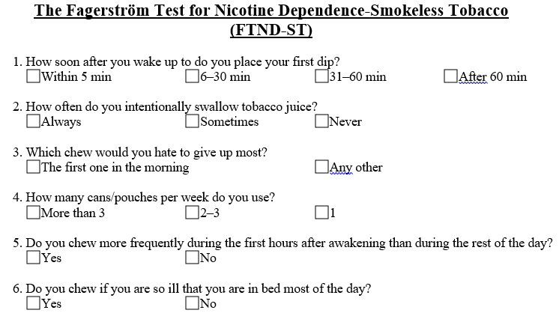
Confirmatory Factor Analysis
Example – Structure model of FTND-ST
Unidimensional vs. multidimensional

Slide 66
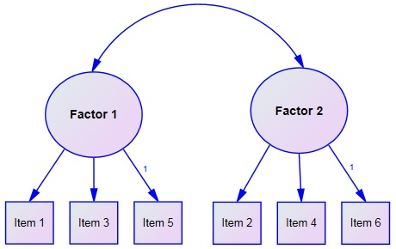
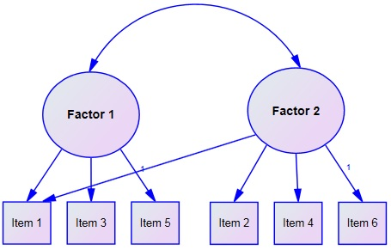
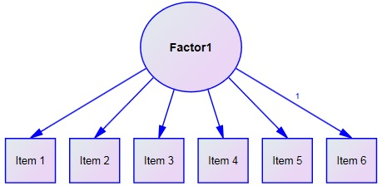
Confirmatory Factor Analysis
Model A: Two-factor solution
Model B: Two-factor solution
Model C: Unidimensional

Slide 67
Confirmatory Factor Analysis
AMOS Results – Model A

Slide 68
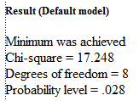
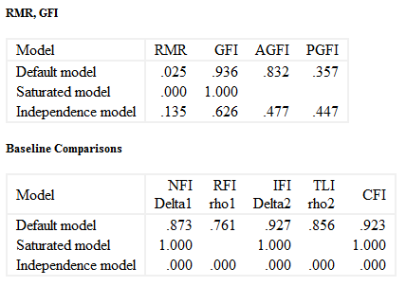
Confirmatory Factor Analysis
AMOS Results – Model A

Slide 69
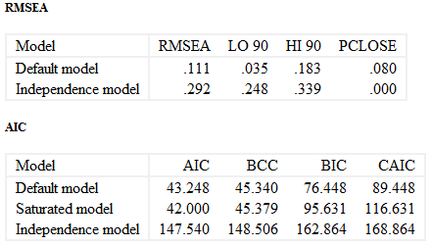
Confirmatory Factor Analysis
AMOS Results – Model A

Slide 70
Confirmatory Factor Analysis
SAS Syntax – Model A
Proc Calis Data=OSCTR_CFA;
Factor
Factor1 ---> FTND_1,
Factor1 ---> FTND_3,
Factor1 ---> FTND_5,
Factor2 ---> FTND_2,
Factor2 ---> FTND_4,
Factor2 ---> FTND_6;
Pvar
Factor1 = 1.,
Factor2 = 1.;
Fitindex NoIndexType On(only)=[Chisq df ProbChi GFI BentlerCFI SRMSR RMSEA_LL RMSEA UL_RMSEA];
Run;

Slide 71
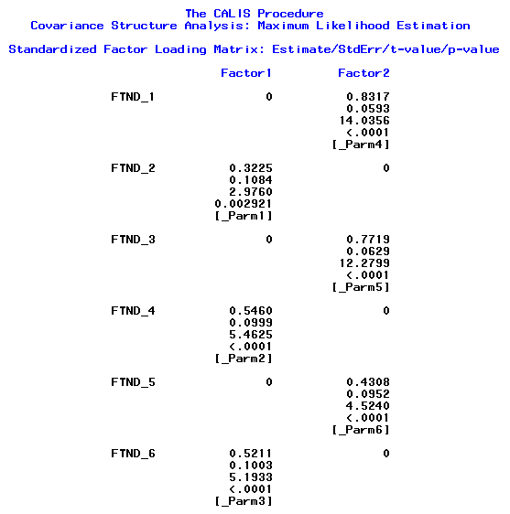
Confirmatory Factor Analysis
SAS Output
Factor Loadings

Slide 72
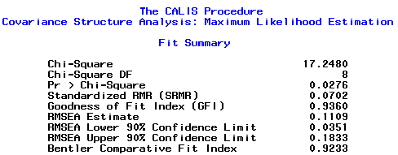
Confirmatory Factor Analysis
SAS Output – Model A
Fit Summary

Slide 73
Confirmatory Factor Analysis
AMOS Results – Model B

Slide 74
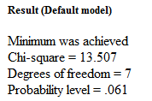
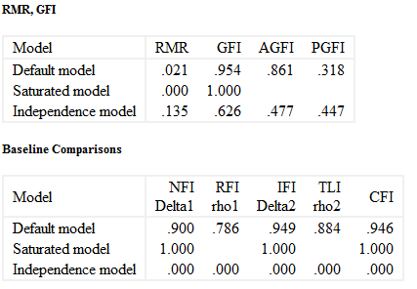
Confirmatory Factor Analysis
AMOS Results – Model B

Slide 75
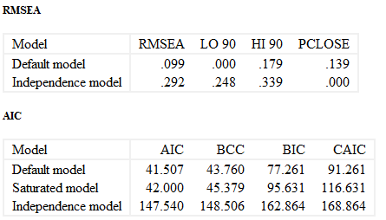
Confirmatory Factor Analysis
AMOS Results – Model B

Slide 76
Confirmatory Factor Analysis
AMOS Results – Model C

Slide 77
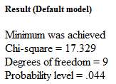
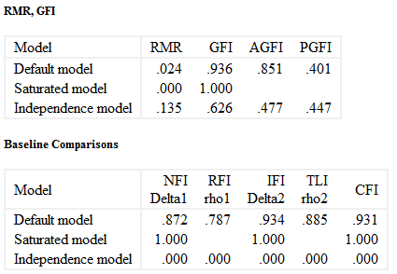
Confirmatory Factor Analysis
AMOS Results – Model C

Slide 78
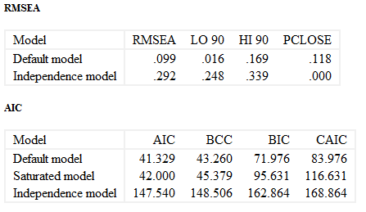
Confirmatory Factor Analysis
AMOS Results – Model C

Slide 79
Confirmatory Factor Analysis
Revising the factor model
Fit of the hypothesized model is not satisfactory
Model respecification is performed
Model modification indexes help in respecifiying the model
Help determine parameters in the model which are misspecified.
Identify constraints in the model.
E.g., Correlation between two factors which was not specified in the original model or correlation between two indicators’ error terms.
Modification Index (MI) Value - Freeing the specified constraint will lower the chi-square value.
Identified constraints should be freed one at a time.
Respecification based on MI should be aligned with the theoretical framework of the model (scale).

Slide 80
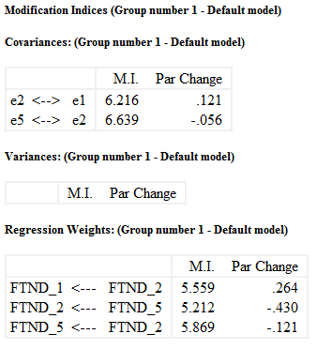
Confirmatory Factor Analysis
AMOS Results – Model C
M.I. Anticipated decrease in chi-square if this constrain is freed.
If you repeat the analysis treating the covariance between e2 and e1 as a free parameter, the discrepancy will fall by at least 6.216.
Par Change: If you repeat the analysis treating the covariance between e2 and e1 as a free parameter, its estimate will become larger by approximately 0.121 than it is in the present analysis.

Slide 81
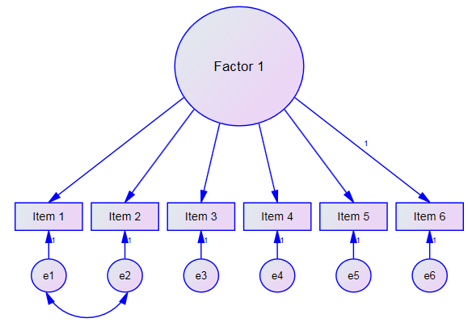
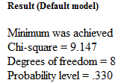
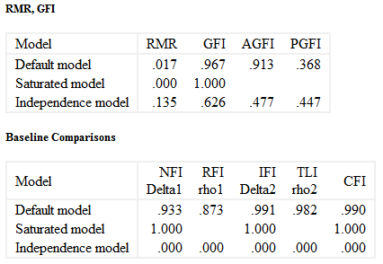
Confirmatory Factor Analysis
AMOS Results – Respecified Model C

Slide 82
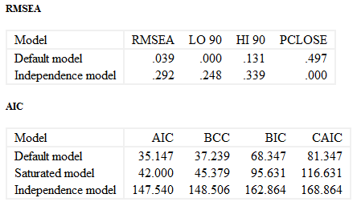
Confirmatory Factor Analysis
AMOS Results – Respecified Model C

Slide 83
Confirmatory Factor Analysis
Table 5. Comparison of structure models of FTND-ST
Model | Model Fit Indexes
 | χ² | GFI | CFI | TLI | SRMR | RMSEA (90%CI) | AIC
Model A: Two Factors Factor 1→ Items 1,3,5 Factor 2→ Items 2,4,6 | 17.248 (df=8, p=0.028) | 0.936 | 0.923 | 0.856 | 0.070 | 0.111 (0.035. 0.830) | 43.248
Model B: Two Factors Factor 1→ Items 1,3,5 Factor 2→ Items 1,2,4,6 | 13.507 (df=7, p=0.061) | 0.954 | 0.946 | 0.884 | 0.067 | 0.099 (0.000, 0.179) | 41.507
Model C: Single Factor (Unidimensional Scale) | 17.329 (df=9, p=0.044) | 0.936 | 0.931 | 0.885 | 0.071 | 0.099 (0.016, 0.169) | 41.329
Model C: Single Factor* (Unidimensional Scale) | 9.147 (df=8, p=0.33) | 0.967 | 0.990 | 0.982 | 0.059 | 0.039 (0.000, 0.131) | 35.147
* Model respecification was performed by specifying correlated error between items 1 and 2.

Slide 84
Factor Analysis
Important considerations
EFA vs. CFA
Sample size
First-order model vs. higher-order factor model

Slide 85
Validity Diagnostic Accuracy

Slide 86
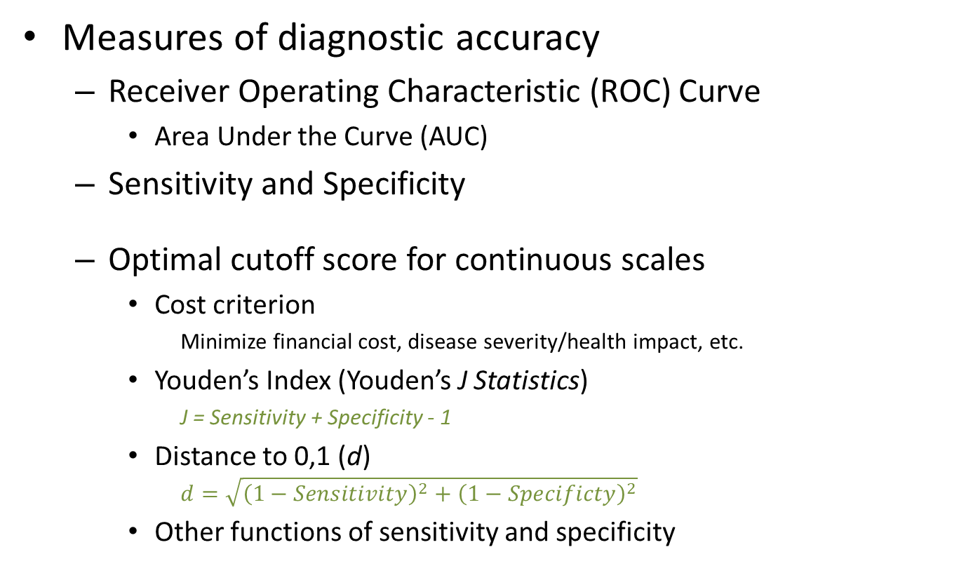
Validity of diagnostic scales
Measures of diagnostic accuracy
Receiver Operating Characteristic (ROC) Curve
Area Under the Curve (AUC)
Sensitivity and Specificity
Optimal cutoff score for continuous scales
Cost criterion
Minimize financial cost, disease severity/health impact, etc.
Youden’s Index (Youden’s J Statistics)
J = Sensitivity + Specificity - 1
Distance to 0,1 (d)
$$d=\sqrt{{\left(1−Sensitivity\right)}^{2}+{\left(1−Specificty\right)}^{2}}$$
Other functions of sensitivity and specificity

Slide 87
Validity of diagnostic scales
ROC Curve
Example: Diagnostic accuracy of FTND-ST for TDS based dependence diagnosis
SAS Syntax
Only ROC curve
ODS Graphics ON;
Proc Logistic Data=FTND Descending Plots=ROC;
Model TDSDiag = FTNDTotal;
Run;
Quit;
ODS Graphics OFF;

Slide 88
Validity of diagnostic scales
ROC Curve
SAS Syntax
ODS Graphics ON;
Proc Logistic Data=FTND Descending;
Model TDSDiag = FTNDTotal / OUTROC=ROC ;
ROC; ROCContrast;
Run;
Quit;
ODS Graphics OFF;
OUTROC: Generates a dataset with sensitivity and 1-specificity for each possible threshold value plotted in the ROC. Dataset is used for subsequent analysis
ROC: Statistics for ROC model and ROC curve
ROCContrast: Comparisons among models

Slide 89
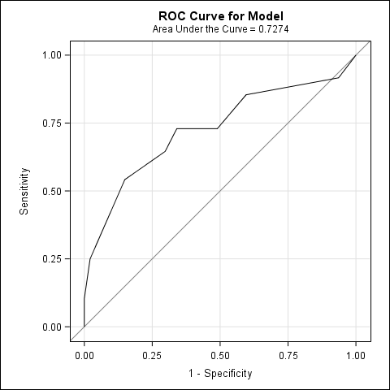
Validity of diagnostic scales
ROC Curve
SAS OUTPUT

Slide 90
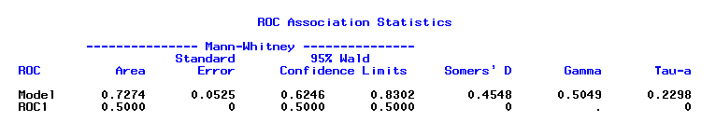

Validity of diagnostic scales
ROC Curve
SAS OUTPUT – Overall accuracy
AUC=0.727, 95%CI (0.645, 0.830)
AUC is significant
95%CI does not include 0.5 (AUC of diagonal line)
P-value < 0.05

Slide 91
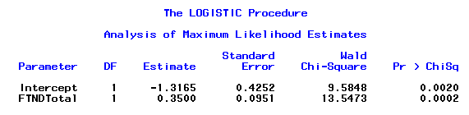
Validity of diagnostic scales
ROC Curve
SAS OUTPUT
Model’s Intercept and slope will be used to determine the cutoff score.

Slide 92
Validity of diagnostic scales
Optimal cutoff score
SAS Syntax
Data ROC2; Set ROC;
Logit = Log (_prob_/(1 - _prob_));
Cutoff = (Logit + 1.3165)/0.3500;
Sensitivity = _sensit_;
Specificity = 1- _1mspec_;
Youden = Sensitivity+Specificity-1;
Distance = SQRT(((1-Sensitivity)**2)+((1-Specificity)**2));
Run;
Proc Sort Data=ROC2;
By Descending YJ;
Run;
Proc Print Data=ROC2 NoObs;
Var Cutoff Sensitivity Specificity YJ Distance;
Run;

Slide 93
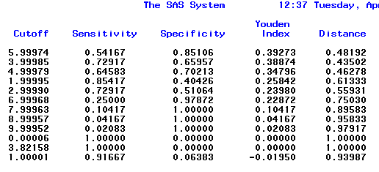
Validity of diagnostic scales
Optimal cutoff score
SAS Output
Use cost criterion to determine optimal cutoff score
Sensitivity vs. Specificity

Slide 94
References
Abell, N., Springer, D. W., & Kamata, A. (2009). Developing and validating rapid assessment instruments. Oxford ; New York: Oxford University Press.
DeVellis, R. F. (2017). Scale development : theory and applications (Fourth edition). Los Angeles: SAGE.
Dimitrov, D. M. (2012). Statistical methods for validation of assessment scale data in counseling and related fields. Alexandria, VA: American Counseling Association.
Nunnally, J. C., & Bernstein, I. H. (1994). Psychometric theory (Third Edition). New York: McGraw-Hill.
Shultz, K. S., Whitney, D. J., & Zickar, M. J. (2014). Measurement theory in action : case studies and exercises (Second Edition). New York: Routledge.

Slide 95
Questions

