Slide 1
Introduction to Multiple Imputation
Sixia Chen, PhD
OSCTR BERD Novel Methodology Unit Workshop
10/24/2024

Slide 2
Acknowledgement
This workshop was supported by the Oklahoma Shared Clinical and Translational Resources (U54GM104938) with an Institutional Development Award (IDeA) from NIGMS. The content is solely the responsibility of the authors and does not necessarily represent the official views of the National Institutes of Health

Slide 3
Please keep presentation slides, data files, and computational codes confidential and don’t share with others
Please use the data files only for the purpose of this short course
We will only use SAS for real data applications and in-class exercise

Slide 4
Course Objectives
Obtain basic knowledge of missing data and multiple imputation
Implement multiple imputation method by using SAS
Apply multiple imputation method in practice

Slide 5
Outline
Introduction to missing data analysis
Multiple imputation method
Computational tools
Real data application
Discussion

Slide 6
1. Introduction to missing data analysis

Slide 7
Introduction - Types of missing data
Unit nonresponse: it occurs when an entire unit, such as a person, household, or case, fails to provide any data for the survey or study. This means that none of the variables or questions related to that unit have been answered or collected
Item nonresponse: it occurs when a participant or respondent provides some data but fails to answer one or more specific questions or variables in a survey or study

Slide 8
Introduction - Examples
The Behavioral Risk Factor Surveillance System (BRFSS): nation’s premier system of health-related telephone surveys that collect state data about U.S. residents regarding their health-related risk behaviors, chronic health conditions, and use of preventive services
Unit nonresponse: refusal and incorrect contact information from the sampled units
Item nonresponse: respondents fail to answer some questions such as age, gender, health outcomes, etc

Slide 9
Unit nonresponse
The response rate for the 2023 Behavioral Risk Factor Surveillance System (BRFSS) was approximately 19.5%
The response rate for the 2023 National Health and Nutrition Examination Survey (NHANES) was around 60%
The response rate for the 2023 National Health Interview Survey (NHIS) was approximately 56.7%

Slide 10
Item nonresponse (2023 BRFSS)
Value | Value Label | Frequency | Percentage | Weighted Percentage
1 | Less than $15,000 Notes: INCOME3=1,2 | 19,187 | 4.43 | 4.88
2 | $15,000 to < $25,000 Notes: INCOME3=3,4 | 31,069 | 7.17 | 7.53
3 | $25,000 to < $35,000 Notes: INCOME3=5 | 38,508 | 8.89 | 8.88
4 | $35,000 to < $50,000 Notes: INCOME3=6 | 47,502 | 10.96 | 10.42
5 | $50,000 to < $100,000 Notes: INCOME3=7,8 | 107,027 | 24.70 | 22.29
6 | $100,000 to < $200,000 Notes: INCOME3=9,10 | 76,637 | 17.69 | 17.49
7 | $200,000 or more Notes: INCOME3=11 | 26,770 | 6.18 | 6.78
9 | Don’t know/Not sure/Missing Notes: INCOME3=77, 99, or Missing | 86,623 | 19.99 | 21.73

Slide 11
Toy example
True average income: 74,375
Observed average income: 41,000
Bias (%)=(41,000-74,375)/74,375=-44.9%
ID | True Annual Income | Observed Annual Income
1 | 50000 | 50000
2 | 120000
3 | 180000
4 | 20000 | 20000
5 | 70000 | 70000
6 | 30000 | 30000
7 | 90000
8 | 35000 | 35000

Slide 12
Introduction - Strategies
Unit nonresponse: Calibration or propensity score weighting
Item nonresponse: Imputation
Goal: Reduce nonresponse bias due to missing data
Imputation: the process of replacing missing data with substituted values. The goal of imputation is to create a complete dataset that allows for standard statistical analyses, even when some data points are missing. By filling in these gaps, researchers aim to minimize the bias and inefficiency that can arise from incomplete data

Slide 13
Introduction – Types of imputation methods
Single imputation: Generate imputed value one single time
  Mean/Mode imputation
  Regression imputation
  Hot-deck imputation
  Nearest neighbor imputation
Multiple imputation: Generate multiple imputed values

Slide 14
Introduction – Missing mechanism
Missing Completely at Random (MCAR): the probability of a data point being missing is independent of both the observed and unobserved data
Missing Completely at Random (MAR): the probability of a data point being missing is related to the observed data but not to the unobserved data
Not Missing at Random (NMAR): the probability of a data point being missing is related to the unobserved, missing data itself

Slide 15
2. Multiple imputation method

Slide 16
Concept
Multiple imputation is a statistical technique used to handle missing data by creating multiple complete datasets, each with different plausible values imputed for the missing data. These datasets are then analyzed separately, and the results are combined to produce final estimates that account for the uncertainty introduced by the missing data

Slide 17
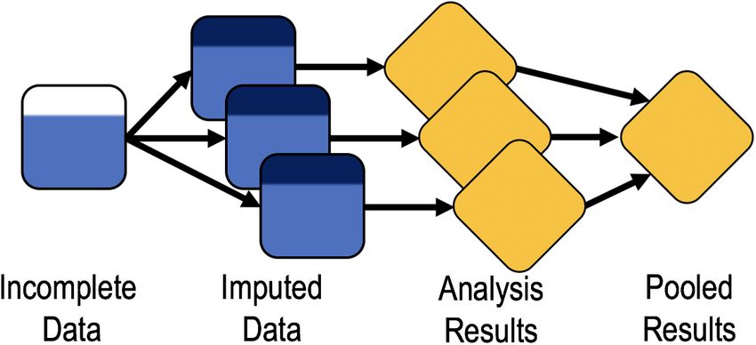
Process

Slide 18
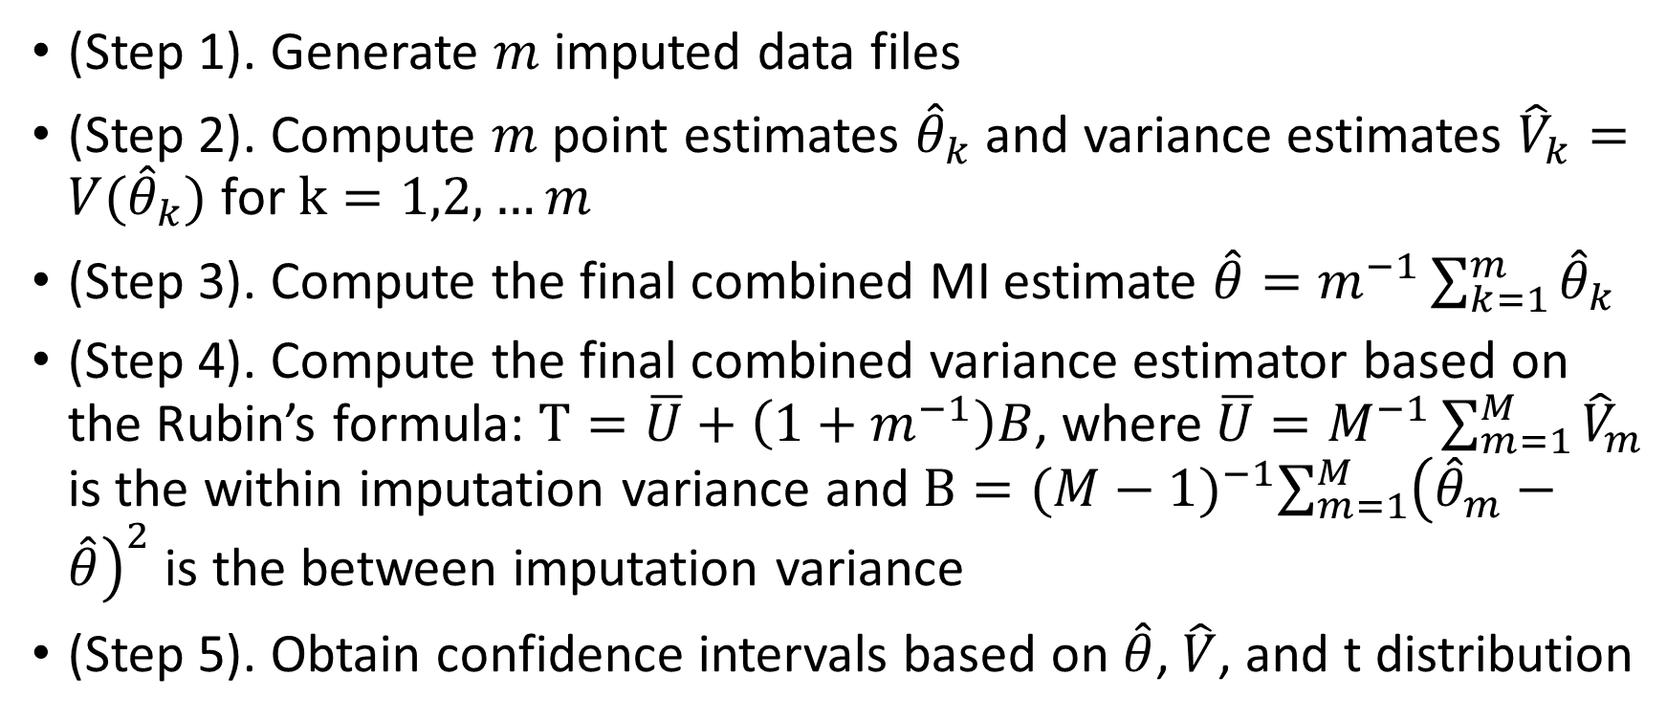
Computational details
(Step 1). Generate $m$ imputed data files
(Step 2). Compute $m$ point estimates ${\hat{θ}}_{k}$ and variance estimates ${\hat{V}}_{k}=V({\hat{θ}}_{k})$ for $k=1,2,…m$
(Step 3). Compute the final combined MI estimate $\hat{θ}=m^{−1}\sum_{k=1}^{m}{{\hat{θ}}_{k}}$
(Step 4). Compute the final combined variance estimator based on the Rubin’s formula: $T=\overline{U}+\left(1+m^{−1}\right)B$, where$\overline{U}=M^{−1}\sum_{m=1}^{M}{{\hat{V}}_{m}}$ is the within imputation variance and $B={(M−1)}^{−1}\sum_{m=1}^{M}{{\left({\hat{θ}}_{m}−\hat{θ}\right)}^{2}}$ is the between imputation variance
(Step 5). Obtain confidence intervals based on $\hat{θ}$, $\hat{V}$, and t distribution

Slide 19
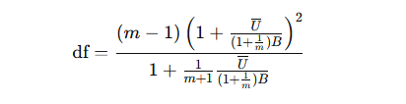

Degrees of Freedom for t distribution
The degrees of freedom associated with the pooled estimate can be approximated as:
When $df$ is large, it can be approximated by using normal distribution

Slide 20

Relative Increase in Variance (RIV)
In multiple imputation (MI), the relative increase in variance (RIV) measures how much the variance of an estimate increases due to the uncertainty introduced by imputing missing data, compared to if there were no missing data. It quantifies the additional uncertainty associated with estimating the missing values.
Formula:

Slide 21
Interpretation
The RIV helps understand how much missing data impacts the reliability of the estimates after multiple imputation. As m increases (more imputations), the RIV decreases, leading to more stable estimates
Rule of Thumb:
  RIV<0.1: Good handling of missing data
  RIV between 0.1 and 0.3: Acceptable, but some increased variance due to missing data
  RIV>0.5: Suggests a need for careful review of the imputation process or increasing the number of imputations

Slide 22

Fraction of Missing Information (FMI)
Formula:
Rule of Thumb:
  FMI<0.1: Good; minimal impact from missing data
  FMI between 0.1 and 0.3: Acceptable; moderate but manageable impact
  FMI>0.3: Significant influence from missing data; requires closer examination of the imputation strategy

Slide 23

Relative Efficiency
It measures how close (efficient) the variance of the estimate based on multiple imputation is to the variance of the estimate that would be obtained with fully complete data
Formula:
RE>0.95 is acceptable

Slide 24
History
Concept Introduction (1978): Rubin introduced the concept of MI in his 1978 paper, where he outlined the theoretical framework
Formalization and Implementation (1980s-1990s): Rubin and others formalized the methodology, developed algorithms, and implemented MI in various statistical software packages. Rubin’s 1987 book, Multiple Imputation for Nonresponse in Surveys, is considered a seminal work in the field, providing a comprehensive treatment of the theory and application of MI
Wider Adoption (1990s-2000s): As computational power increased and software tools improved, MI became more widely adopted in various fields, including social sciences, epidemiology, and economics

Slide 25
Conditions
Missing at Random (MAR) Assumption
Proper Specification of the Imputation Model
Inclusion of All Relevant Variables: include all variables that are related to the missing data and the analysis model
Sufficient Number of Imputations (At least 20)
Convergence of the Imputation Process
Compatibility Between Imputation and Analysis Models
Proper Handling of Multicollinearity

Slide 26
Advantages of MI
Reduces bias
Reflects uncertainty due to imputation
Preserves relationships among variables
Flexible and generalizable
Compatible with standard analysis methods
Widely available in software

Slide 27
Disadvantages of MI
Computationally intensive
Complex implementation
Assumes MAR
Risk of model mis-specification
Potential for increased variability
Interpretation challenges
Dependence on proper software use

Slide 28
3. Computational tools

Slide 29
Computational tools of MI
R: Flexible and comprehensive, with packages like mice, Amelia, and missForest.
SAS: Powerful for MI with PROC MI and PROC MIANALYZE.
SPSS: User-friendly with a GUI for MI through its MVA module.
Stata: Extensive support for MI with the mi command.
Mplus: Excellent for structural equation modeling with MI.
Python: Libraries like Fancyimpute and Statsmodels offer MI functionality.
Standalone: Tools like Amelia and others by Schafer for specific MI needs.

Slide 30
SAS PROC MI
Proc MI seed=04180 nimpute=20 min=0 1 0 . . max=3 5 6 . . round=1 1 1 . . data=indat out=indat2;
Class X4 X5;
fcs reg(X1=X3 X4 X5);
fcs logistic(X4=X1);
fcs REGPMM(X2);
Var X1 X2 X3 X4 X5;
By C1; /*indat needs to be sorted by C1 first*/
Run;

Slide 31
SAS code examples
Means
Linear Regression model
Generalized Linear Model
Percentages and Frequency
Logistic regression model
Nominal Logistic Model
Mixed effect model

Slide 32
4. Real data application

Slide 33
Data and variables
2017-2018 National Health Nutrition and Examination Survey (NHANES): https://wwwn.cdc.gov/nchs/nhanes/continuousnhanes/default.aspx?BeginYear=2017
Data file: Demographics Data
Variables: RIDAGEYR DMDHHSIZ RIAGENDR RIDRETH1 DMDEDUC2 (missing) DMDMARTL (missing) INDFMIN2 (missing)
Research question: Examine the association between INDFMIN2 and other variables

Slide 34
5. Discussion

Slide 35
Multiple imputation (MI) is effective in terms of reducing nonresponse error and improving efficiency
There are existing computational tools (SAS, R, etc.)
MI is flexible in terms of handling different data types

Slide 36
Reference
Griswold, W., and N. Wright. 2004.“Cowbirds, Locals, and the Dynamic Endurance of Regionalism.” American Journal of Sociology109 (6): 1411–51.
Martin, K.A. 2009.“Normalizing Heterosexuality: Mothers’ Assumptions, Talk, and Strategies with Young Children.” American Sociological Review 74: 190–207.
O'Brien, R. 2017.“Redistribution and the New Fiscal Sociology: Race and the Progressivity of State andLocal Taxes.”American Journal of Sociology122 (4): 1015–49.
Sagar, T., D. Jones, K. Symons, J. Tyrie, and R. Roberts. 2016.“Student Involvement in the UK Sex Industry: Motivations and Experiences.” British Journal of Sociology67 (4): 697–718

